Slide 1
The Seisan Earthquake Analysis Software
Lars Ottemöller¹⁾, Peter Voss²⁾ and Jens Havskov¹⁾
University of Bergen
GEUS

Slide 2
Outline
Overview and background
Local earthquake data processing
Catalogue work with SeisanExplorer
Processing of an earthquake using global data
Concluding remarks

Slide 3
What is Seisan?
Seisan is an interactive and efficient software package for processing of earthquake data at seismic observatories

Slide 4
What can you do with SEISAN (basic)
Import/Export data
Store data (waveform and parametric)
Observatory routine:
Analyse earthquake data (signal processing, phase identification, ...)
Compute earthquake parameters (location, magnitude, ...)
Fault plane solution
Seismicity maps
Produce bulletin and catalogue search
Research platform, several additional data processing tools

Slide 5
What can you do with SEISAN (more advanced)
Prepare data for travel time inversion (velest, simulps)
Compute relative times using cross-correlation for hypoDD input
Detection of events in continuous data
Moment tensor inversion using Dreger code
Compute noise and make PDF plots
Crustal Q inversion
Magnitude scale inversion
...

Slide 6
Background
Development started in the late 80s
Large number of software contributors
Steady improvements, now Version 10.2
Basics unchanged
Supported operating systems: Windows, Linux, MacOS and Solaris

Slide 7
Philosophy
Open source
Open system
Non-commercial
Multi-platform
Integrate essential tools and data storage into one package
Documentation
Support
Training

Slide 8
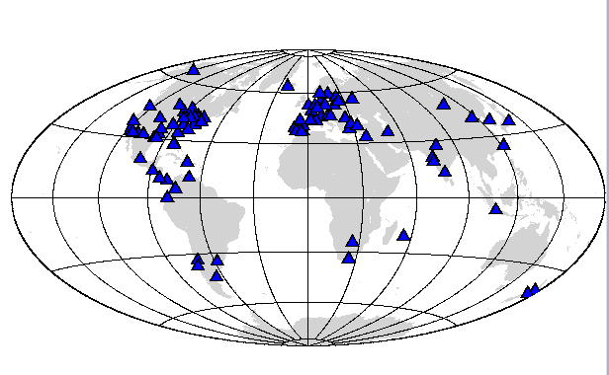
Seisan users
Geographically widely used
>25% of data sent to ISC in SEISAN format
National and regional seismic networks
Volcano observatories
Individual researchers

Slide 9
Formats
Import through conversion of many waveform and parametrics formats
Waveform data: Seisan, miniseed, SEED, GSE, SAC
Parametric data: Seisan
Calibration data: Seisan, GSE, SAC, RESP

Slide 10
Directory structure
C:\seismo
SEISAN-TOP
REA
WAV
CAL
DAT
INF
WOR
TEST
BER
BER
Workspace
Response Files
Documentation
Parameter Files
2005
2006
2005
01
02
03
...
01
02
03
...
Parametric files
Waveform files

Slide 11
Training and support
Fairly regular courses and workshops by University of Bergen and others
Software manual
Training document
Tutorial
Mailing list

Slide 12
Why people may like it
Works even on small Linux and Windows systems
Efficent processing
Open source
Free
Flexible with formats
Support and manual

Slide 13
NMSOP IS11.7: Analysis of a local earthquake in Norway
Date: | 14 Mar 2012
Origin time: | 19:22:27.9 (UTC)
Latitude: | 59.526°N
Longitude: | 5.615°E
Depth: | 13.9 km
ML: | 3.4

Slide 14
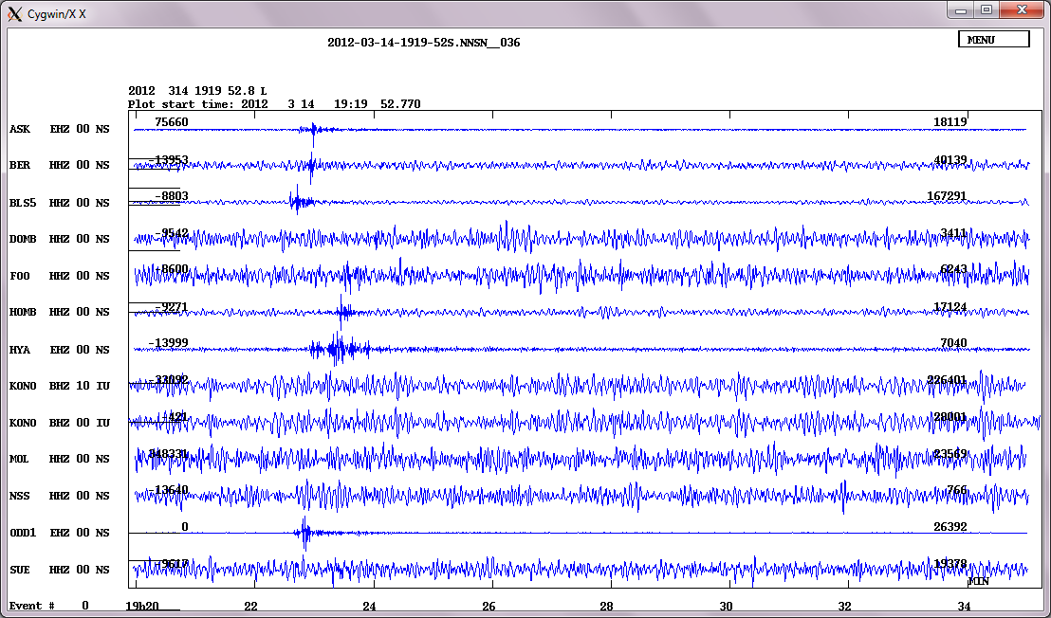

Slide 15
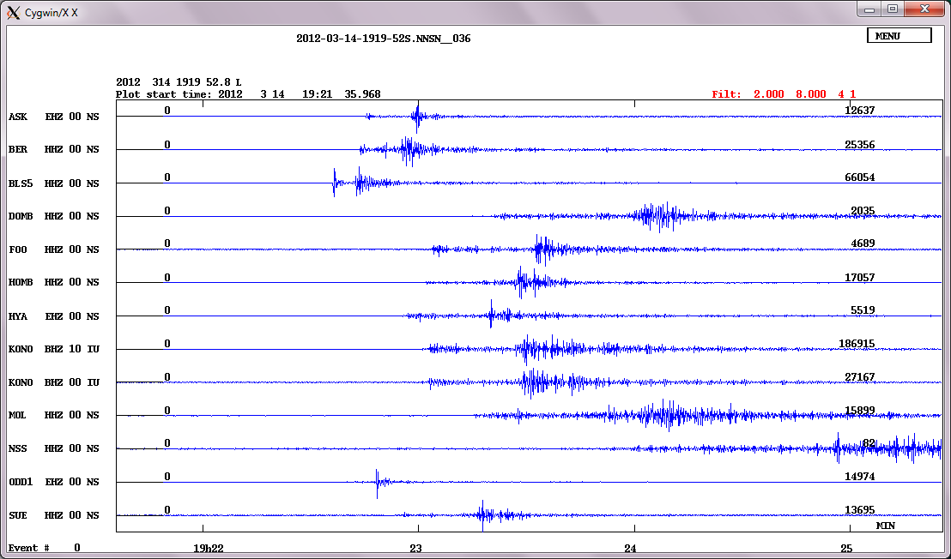

Slide 16
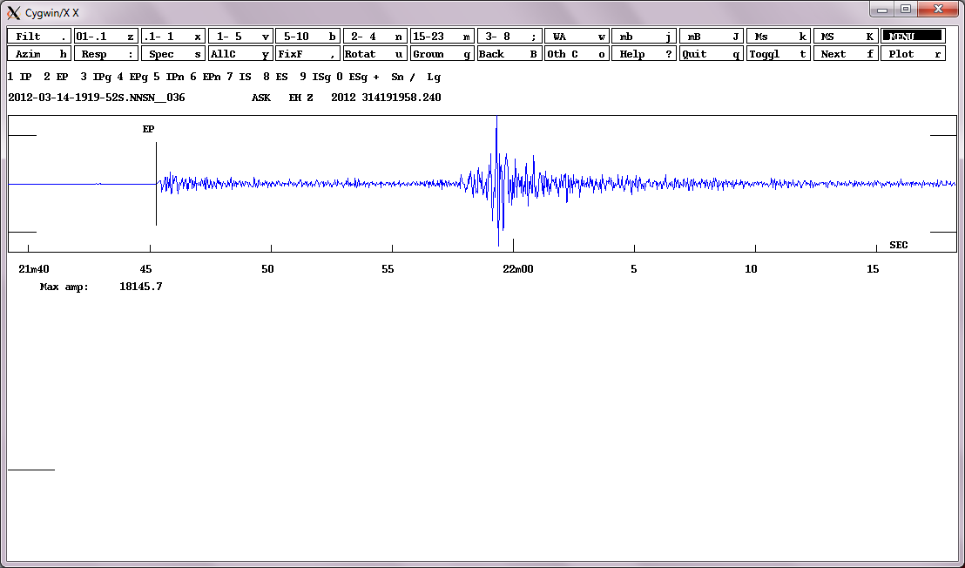

Slide 17
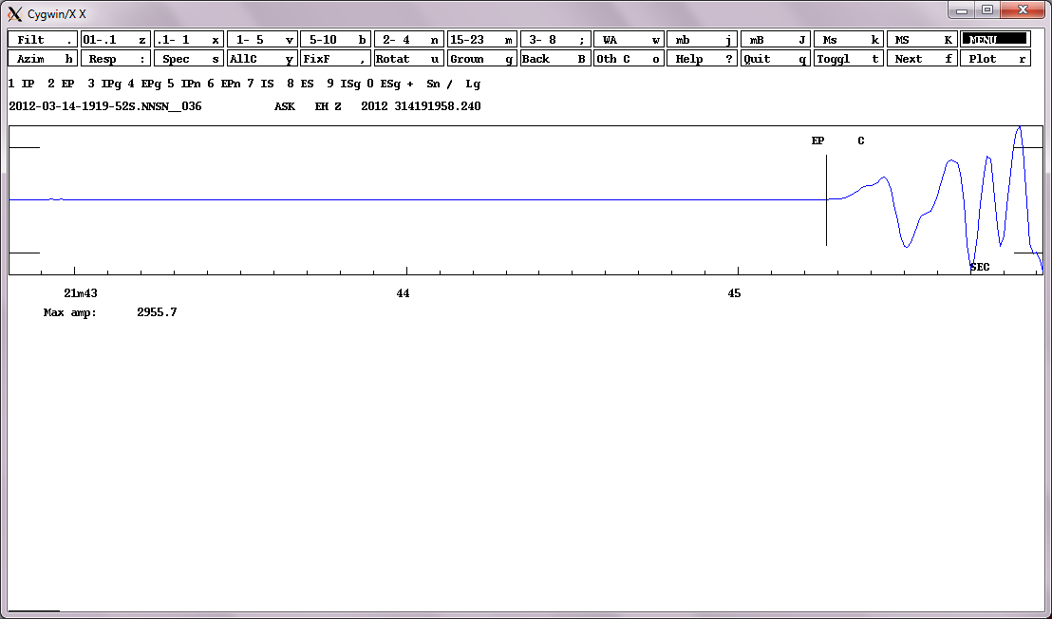

Slide 18
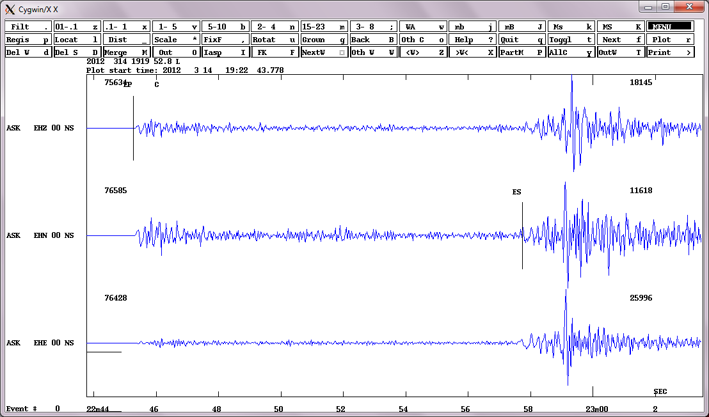

Slide 19
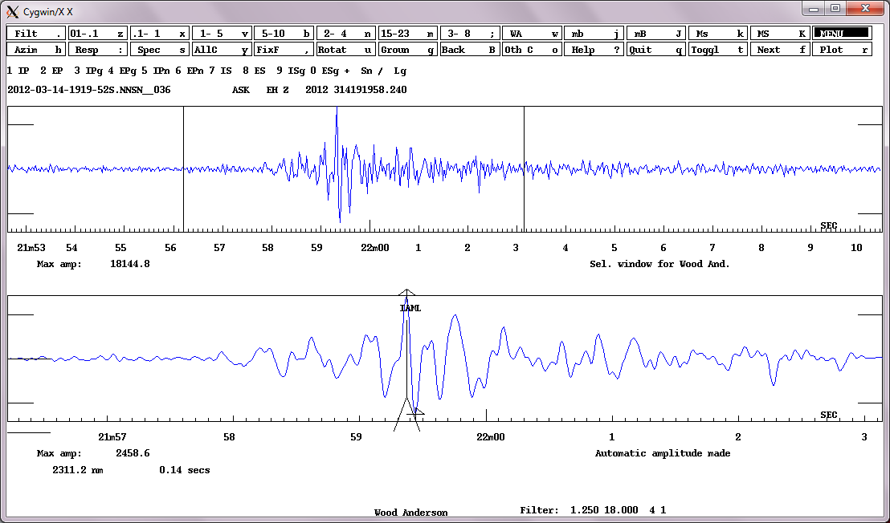

Slide 20
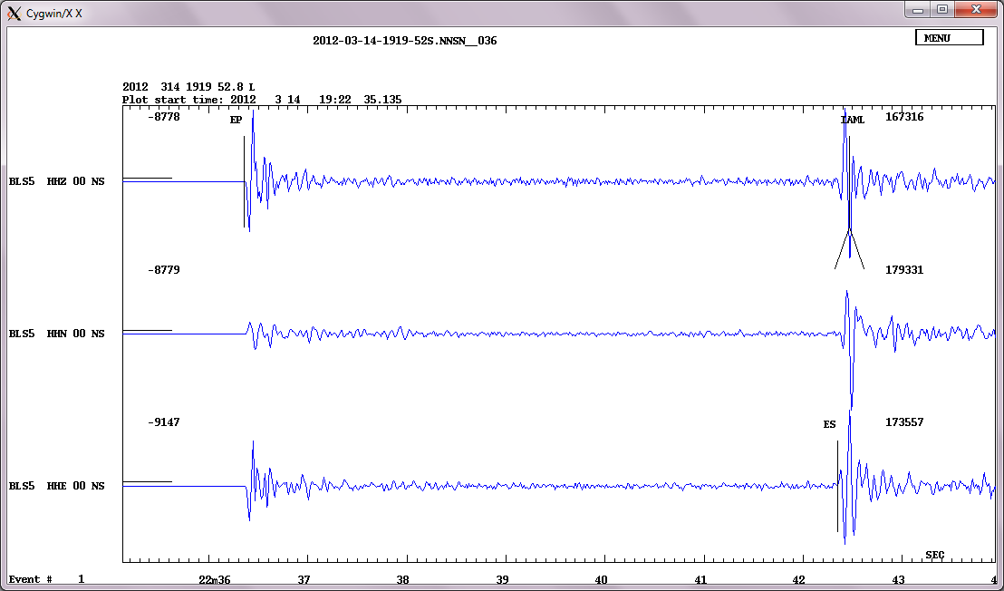

Slide 21
Demonstration

Slide 22
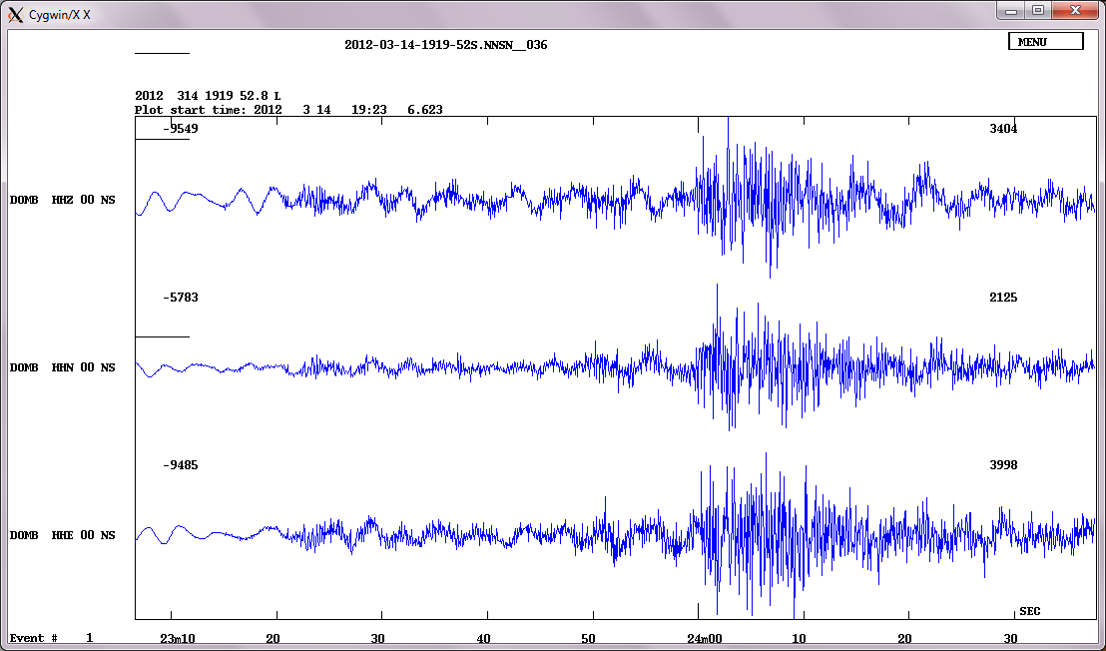

Slide 23
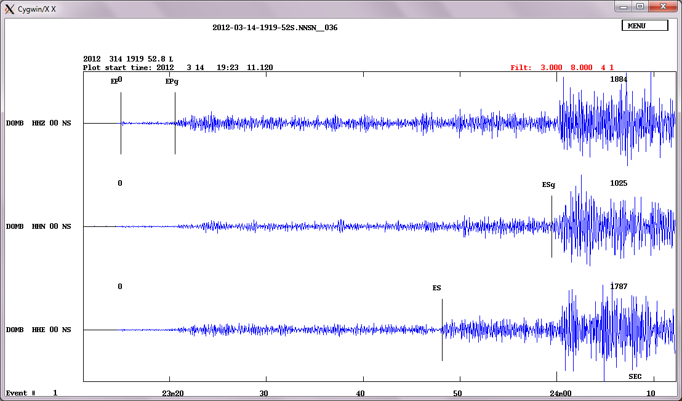

Slide 24
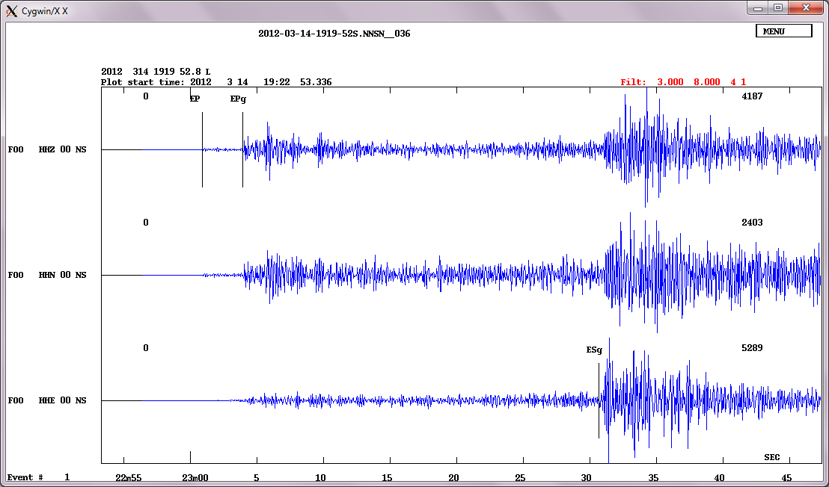

Slide 25
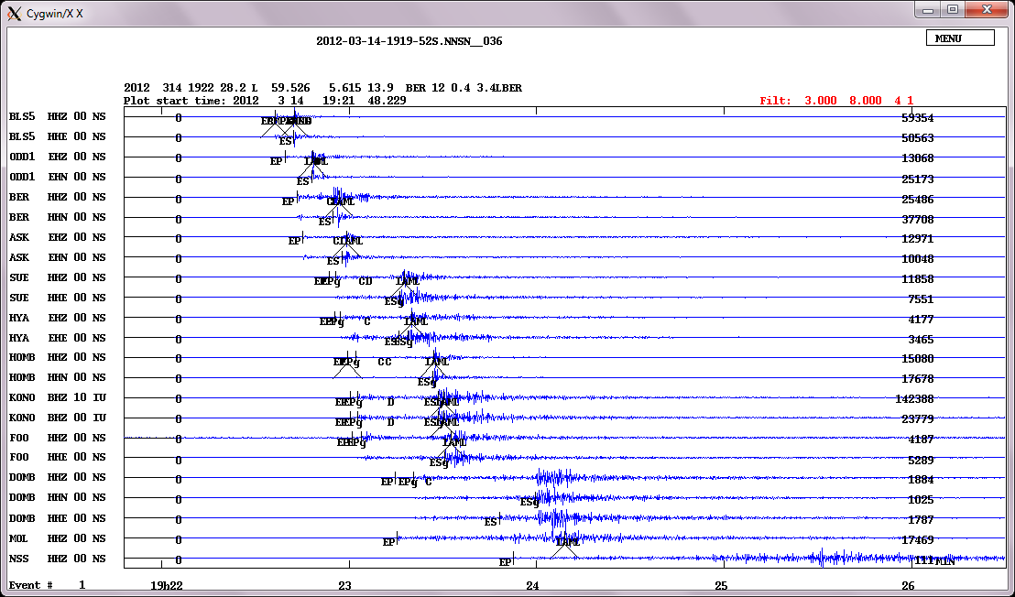

Slide 26
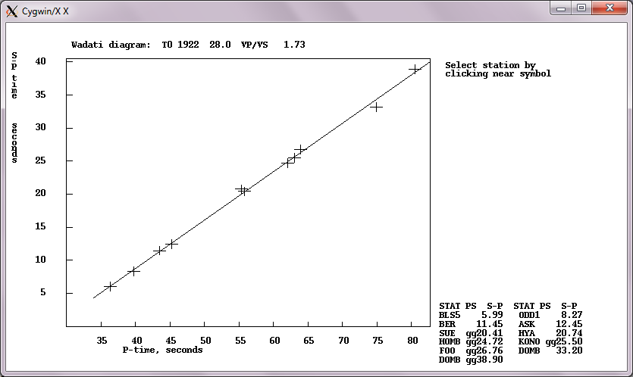
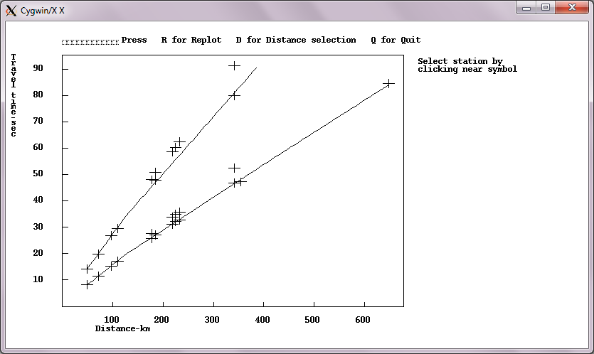
Wadati diagram
Travel time plot

Slide 27
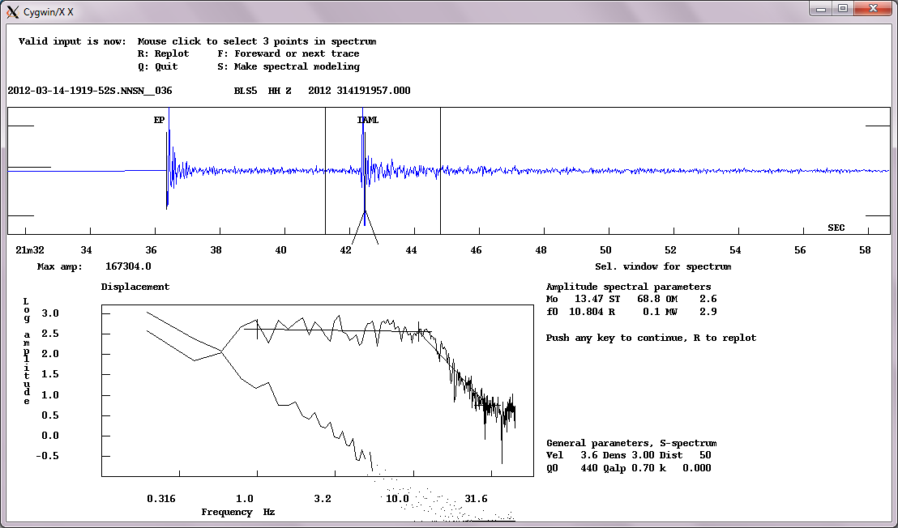

Slide 28
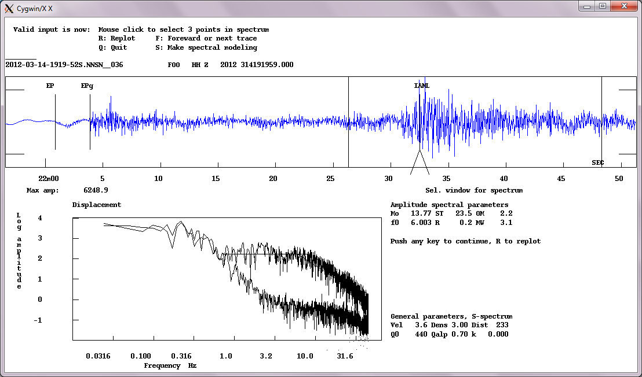

Slide 29
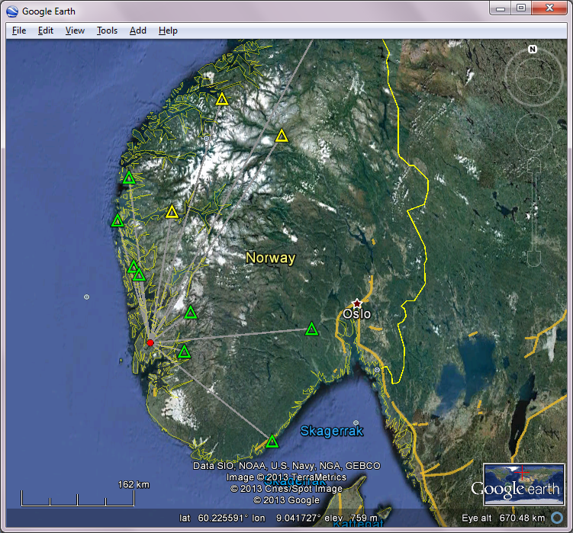
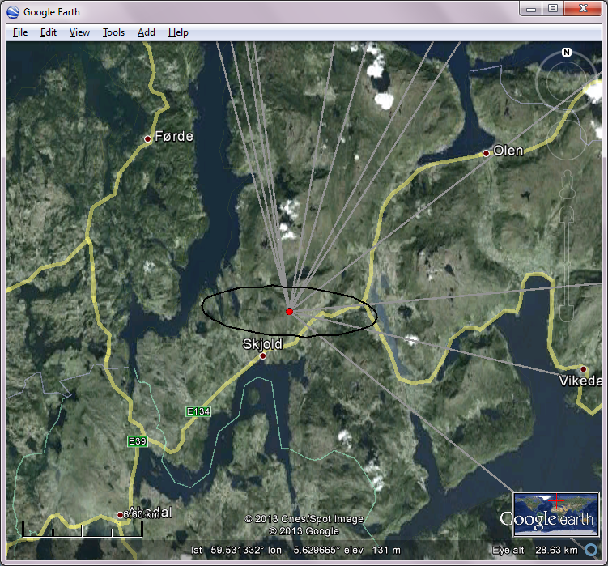

Slide 30
Demonstration
Seisan Explorer

Slide 31
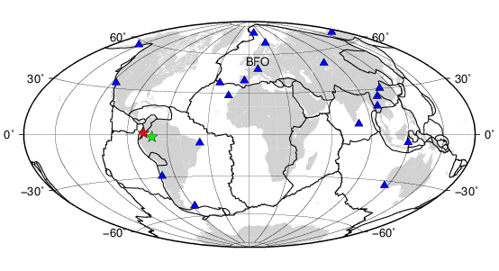
NMSOP IS11.7: Analysis of an intermediate earthquake in Colombia with teleseismic data
Date: | 09/02/2013
Origin time: | 14:16:06.3 (UTC)
Latitude: | 1.14°N
Longitude: | 77.36°W
Depth: | 129 km
Mw: | 7.0

Slide 32
Demonstration

Slide 33
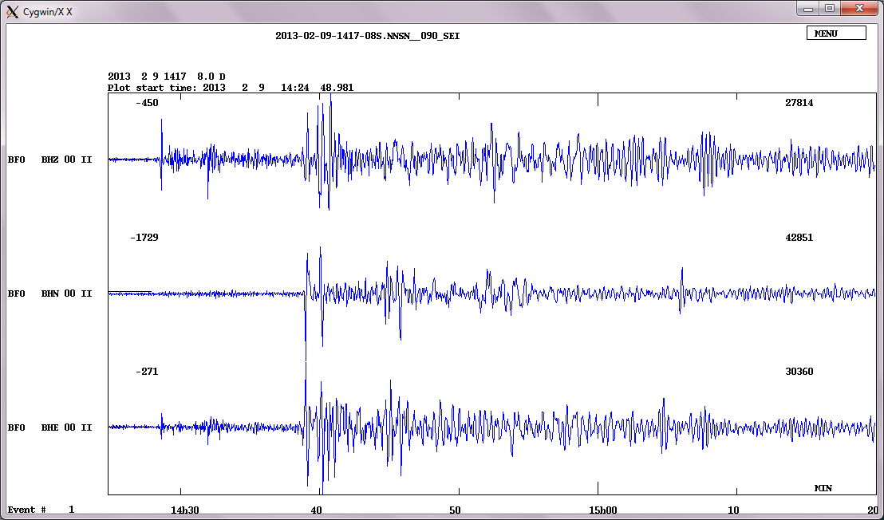

Slide 34
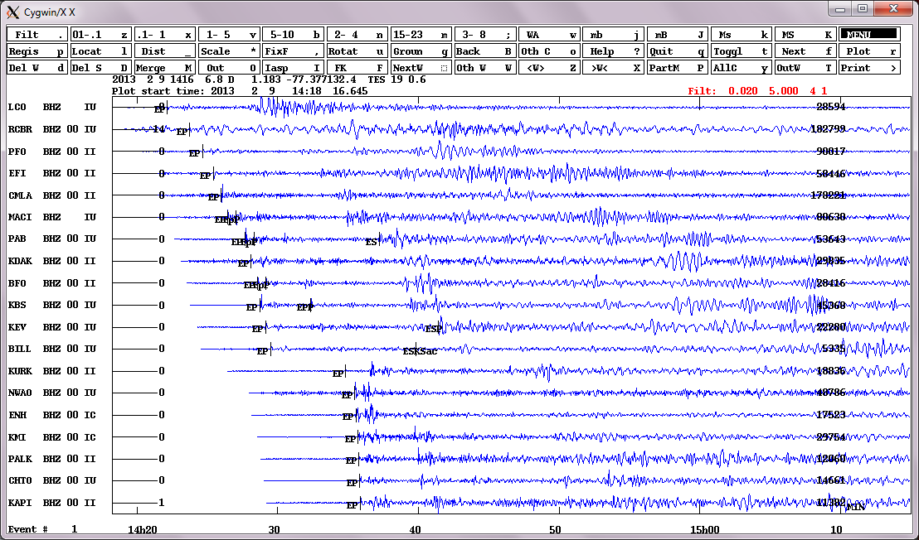

Slide 35
# 1 9 Feb 2013 14:17 8 D ? l
date hrmn sec lat long depth no m rms damp erln erlt erdp
13 2 9 1416 6.75 110.98N 77 22.6W 132.4 19 3 0.64 0.000 15.6 12.3 48.7
stn dist azm ain w phas calcphs hrmn tsec t-obs t-cal res wt di
LCO 3417 168.5 39.7 0 P P 1422 9.6 362.83 362.82 0.01 1.00*17
RCBR 4675 100.0 36.2 0 P P 1423 45.0 458.23 458.28 -0.05 1.00*11
PFO 5430 315.6 33.7 0 P P 1424 39.4 512.70 511.80 0.90 0.97*21
EFI 6139 165.5 31.5 0 P P 1425 25.1 558.33 558.79 -0.47 0.99* 9
CMLA 6665 46.1 29.8 0 P P 1425 59.0 592.23 591.93 0.30 1.00* 6
MACI 7120 59.1 28.4 0 P P 1426 27.2 620.43 619.48 0.95 0.97* 5
PAB 8482 49.6 24.3 0 P P 1427 40.6 693.81 694.00 -0.20 1.00* 3
KDAK 9032 328.4 22.6 0 P P 1428 6.6 719.81 720.90 -1.09 0.96* 5
BFO 9603 41.8 20.8 0 P P 1428 32.9 746.20 747.04 -0.84 0.98* 2
KBS 9876 11.1 19.9 0 P P 1428 45.8 759.07 758.66 0.41 0.99* 1
KEV 10448 19.8 19.4 0 P P 1429 8.0 781.28 782.45 -1.18 0.96* 1
BILL 10966 340.1 18.8 0 P Pdif 1429 29.2 802.41 803.17 -0.76 0.98* 2
KURK 13847 18.3 8.0 0 P PKPdf 1434 49.31122.541123.03 -0.49 0.99* 2
NWAO 16204 202.0 7.0 0 P PKPdf 1435 28.61161.821161.84 -0.02 1.00* 4
ENH 16480 348.7 6.8 0 P PKPdf 1435 33.21166.431165.98 0.45 0.99* 2
KMI 17127 359.8 5.9 0 P PKPdf 1435 42.81176.031175.09 0.94 0.97* 2
PALK 17430 68.7 5.4 0 P PKPdf 1435 45.81179.101178.53 0.57 0.99* 3
CHTO 17789 10.1 4.8 0 P PKPdf 1435 49.51182.781182.46 0.32 1.00* 2
KAPI 18088 257.1 4.2 0 P PKPdf 1435 52.21185.461185.29 0.16 1.00* 3
2013 2 9 1416 6.8 D 1.183 -77.377132.4 TES 19 0.6

Slide 36
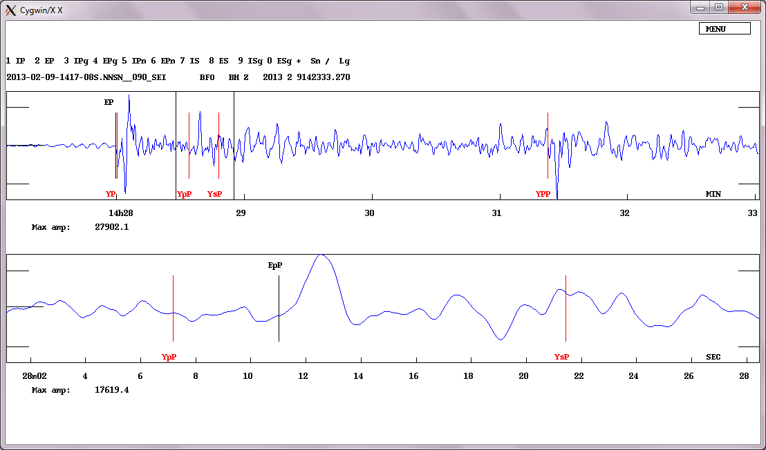

Slide 37
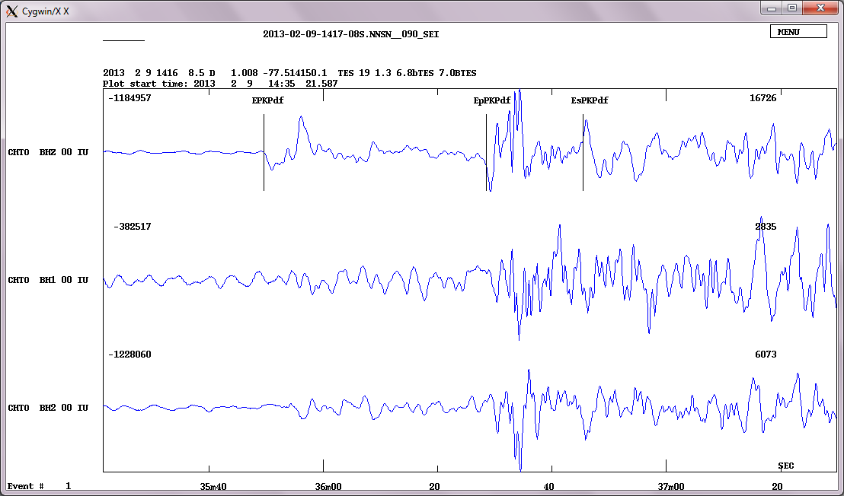

Slide 38
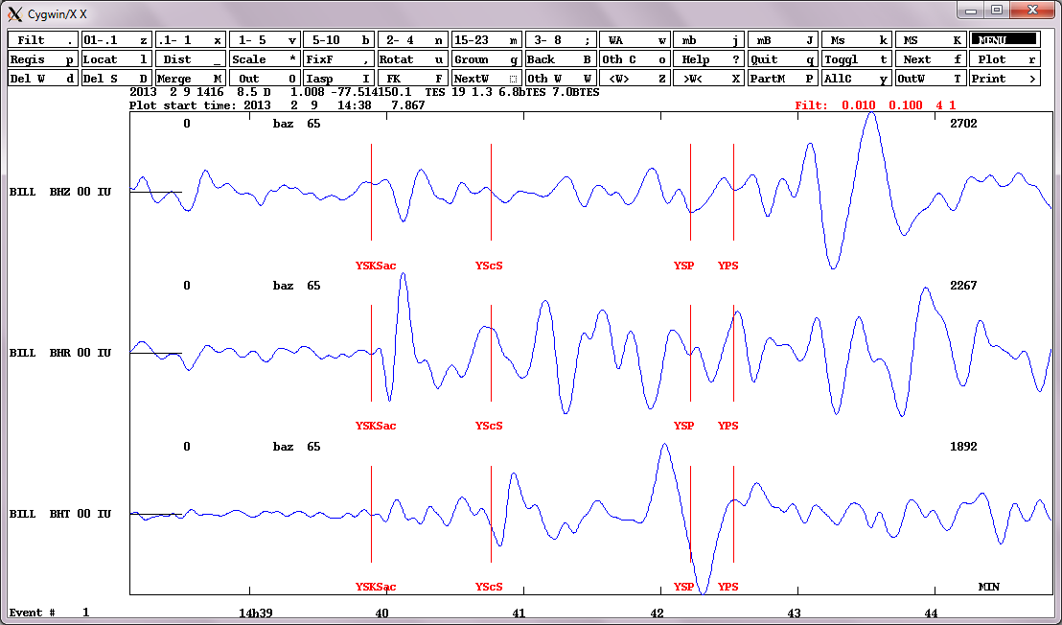

Slide 39
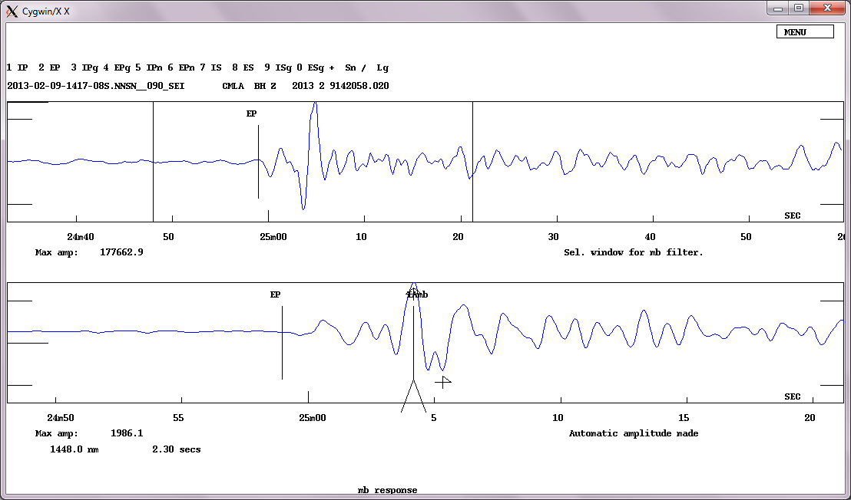

Slide 40
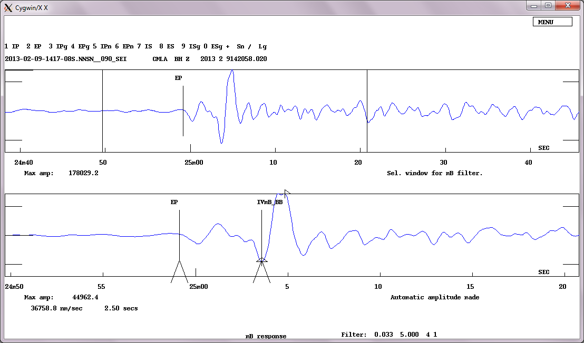

Slide 41
Concluding remarks
Seisan has been a stable processing platform for more than two decades used globally
New developments for better GUI are on the way (e.g., SeisanExplorer)
User support, documentation and courses have helped to make Seisan successful
Efficiency in data processing and combining essential tools into package are the strength of Seisan

Slide 42
Questions?

