Slide 1
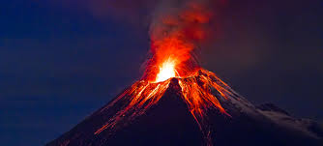
Volcano seismology
Jens Havskov

Slide 2
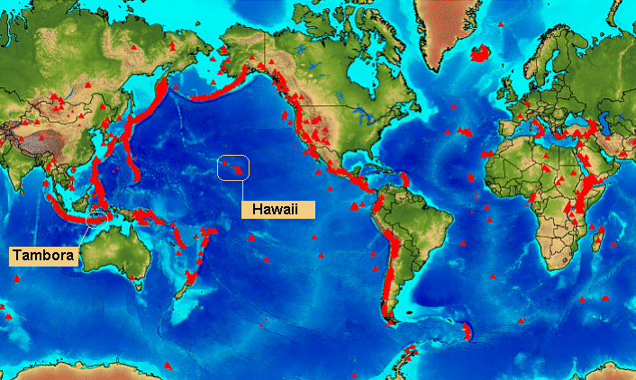
Active volcanos

Slide 3
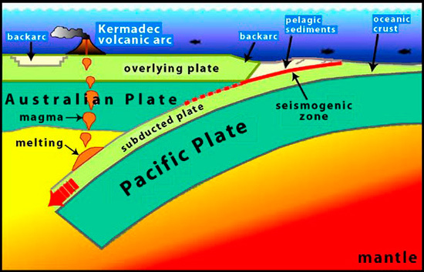
Subduction zone volcano

Slide 4
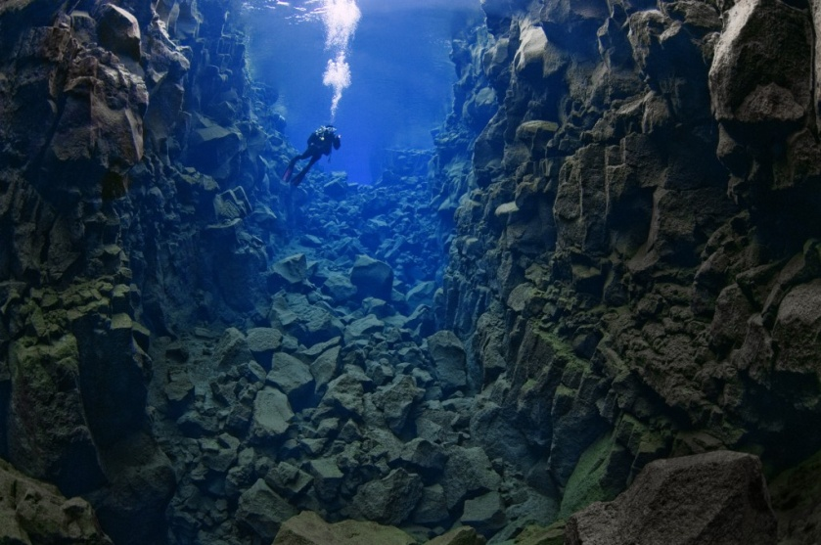
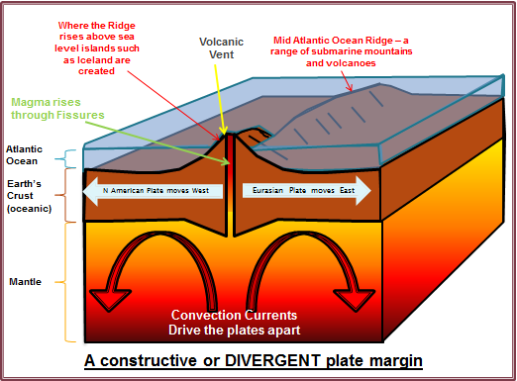
Spreading volcanos
Atlantic rift near Iceland

Slide 5
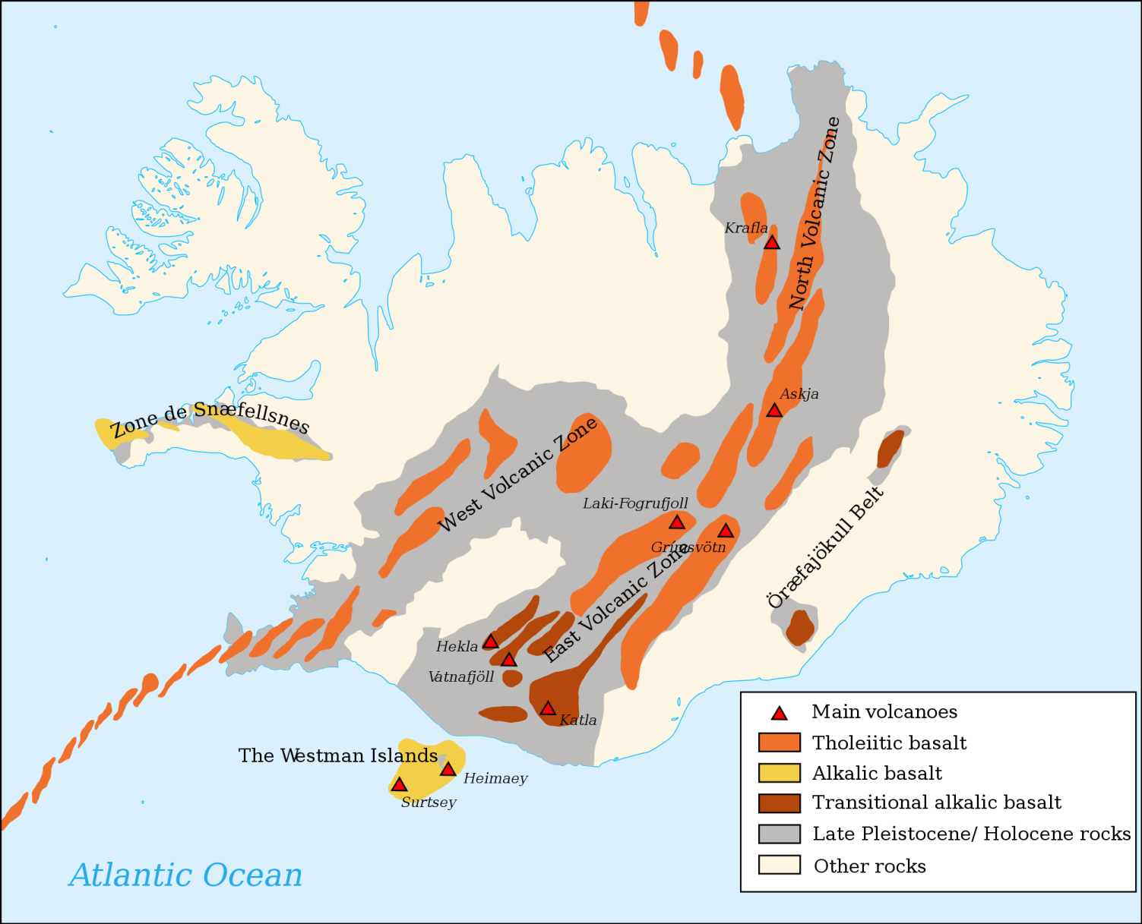
Iceland on a spreading axis

Slide 6
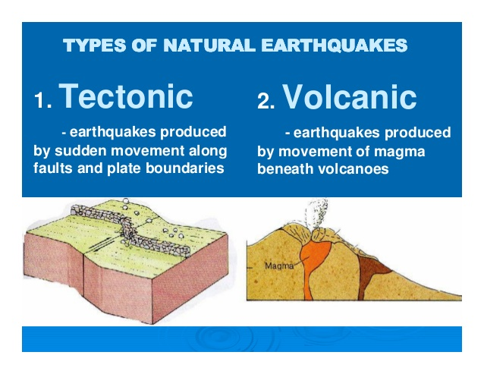
Earthquakes at volcanos

Slide 7
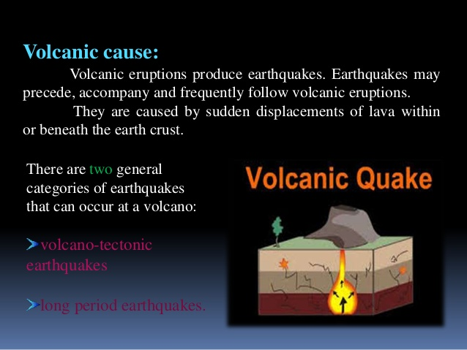
Earthquakes types at volcanos

Slide 8
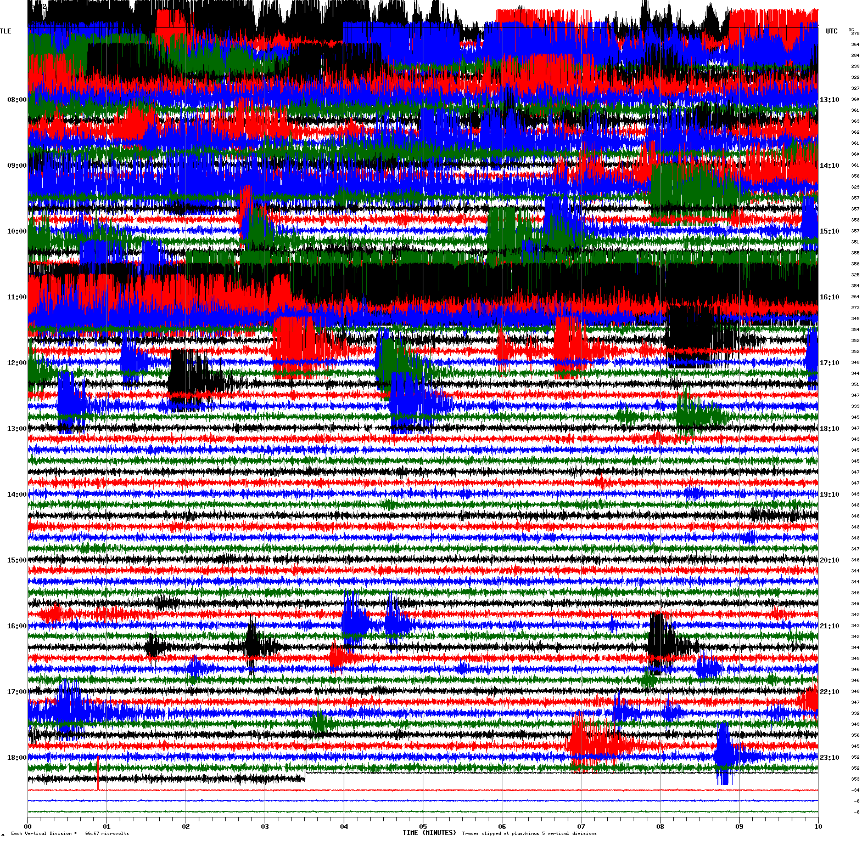
Earthquake swarm at a volcano

Slide 9
Volcano tectonic events

Slide 10
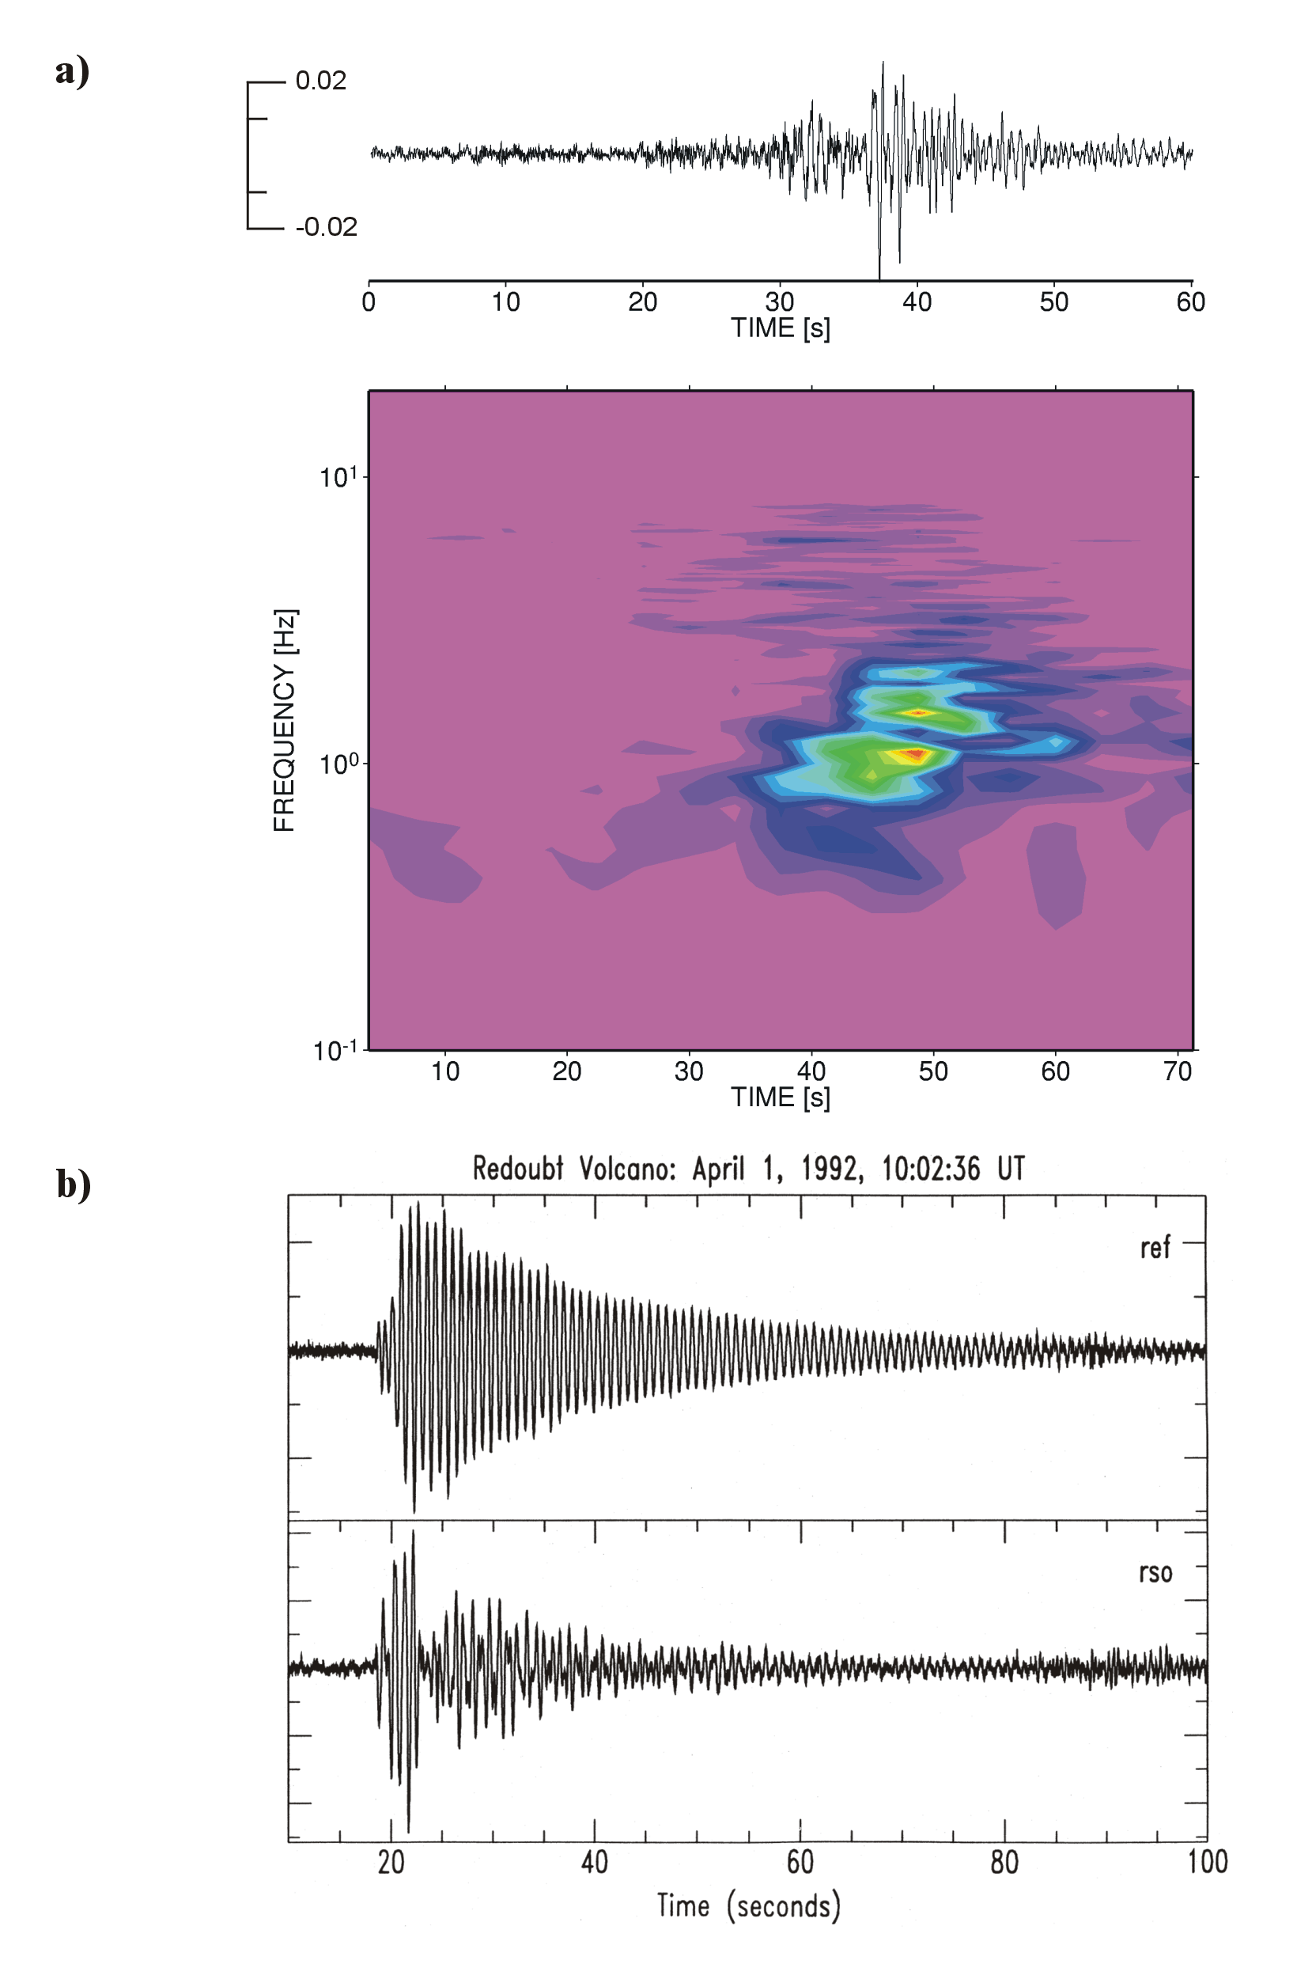
Low frequency events
Example of a LF-wave group recorded at Mt. Merapi. Clearly the dominant frequency is around 1 Hz.
b) shows an example of a LF event recorded at two different sites located at Redoubt volcano, Alaska The spindle shaped signal is also known as Tornillo
Low frequency event caused by:
an opening and resonating crack when the magma is ascending towards the surface
existence of pressure transients within the fluid-gas mixture causing resonance phenomena within the magma itself

Slide 11
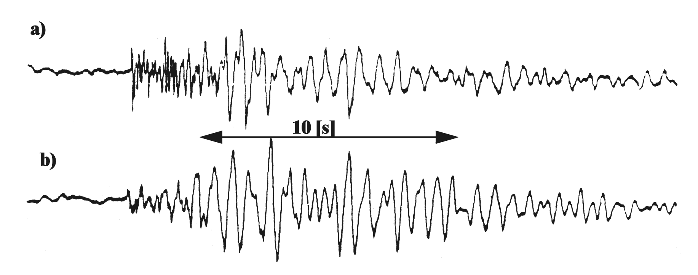
Hybrid events
A Hybrid event
A Volcano-tectonic (VT) event for comparison. The higher frequencies at the beginning of the Hybrid event are an obvious feature, while the later part shows the similarity with the VT event.

Slide 12
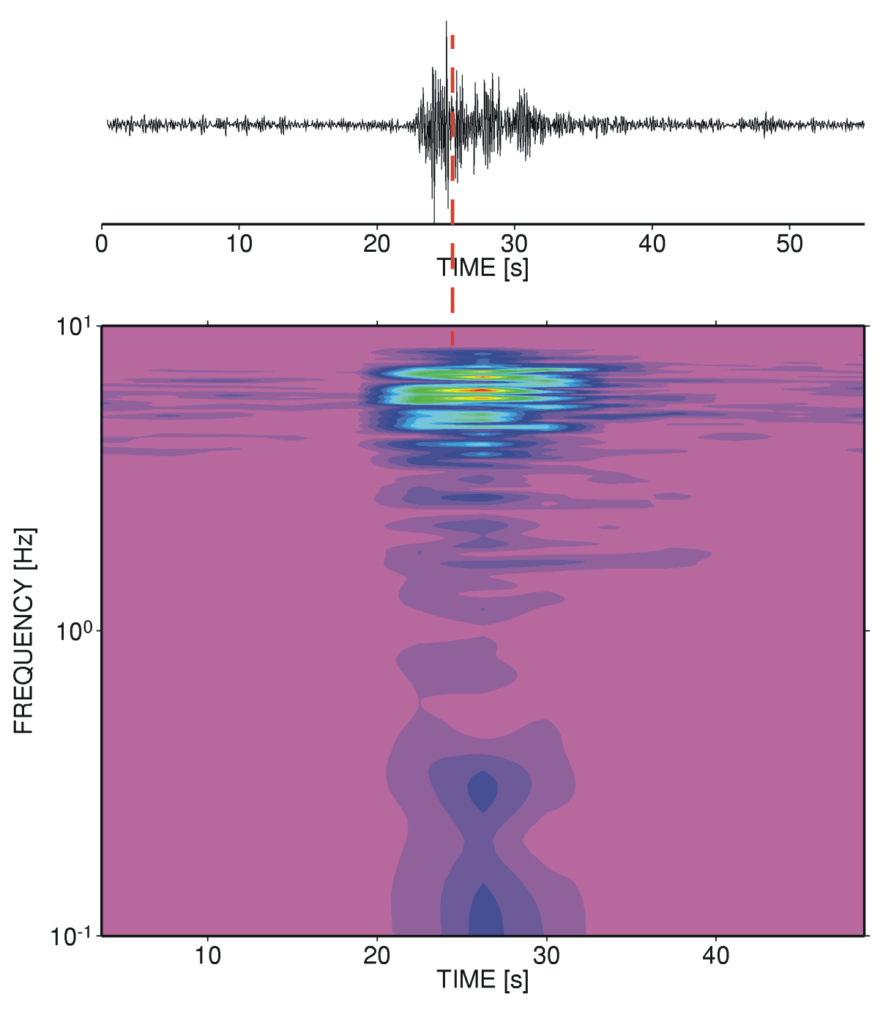
Explosion
An explosion signal recorded at Stromboli volcano, Italy. The seismic station was located just 400 m from the active vent. The dashed line gives a rough estimate of the onset of a sonic wave also visible as high (red) amplitudes in the time-frequency plot around 5 Hz.

Slide 13
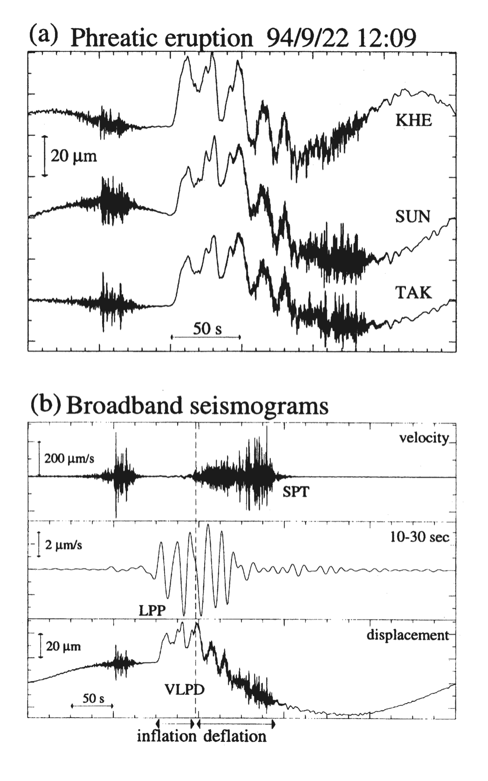
Low frequency signals
Very long-period signal (displacement) observed at three broadband stations during a phreatic eruption of Aso volcano.
(b) Original velocity, band-pass filtered velocity and displacement seismogram of the same event observed at station TAK. The vertical line in b) indicates the onset of the eruption
Low frequency signals are probably caused by the interaction of hot magma/fluid with an aquifer situated in 1 - 1.5 km depth below the craters of Aso volcano.

Slide 14
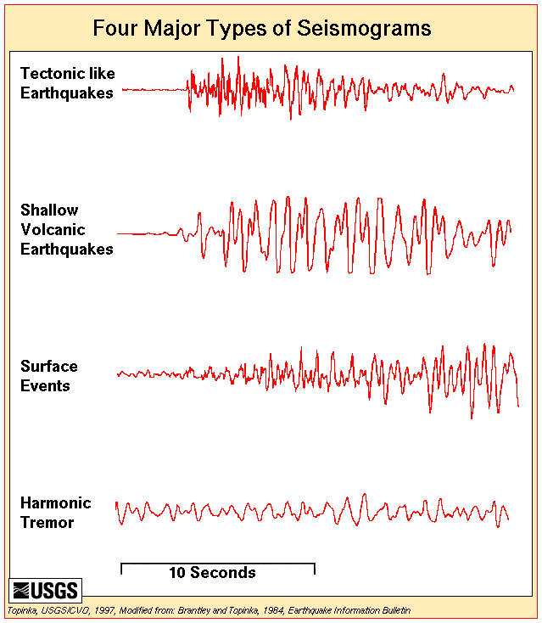
Typical seismograms at a volcano

Slide 15
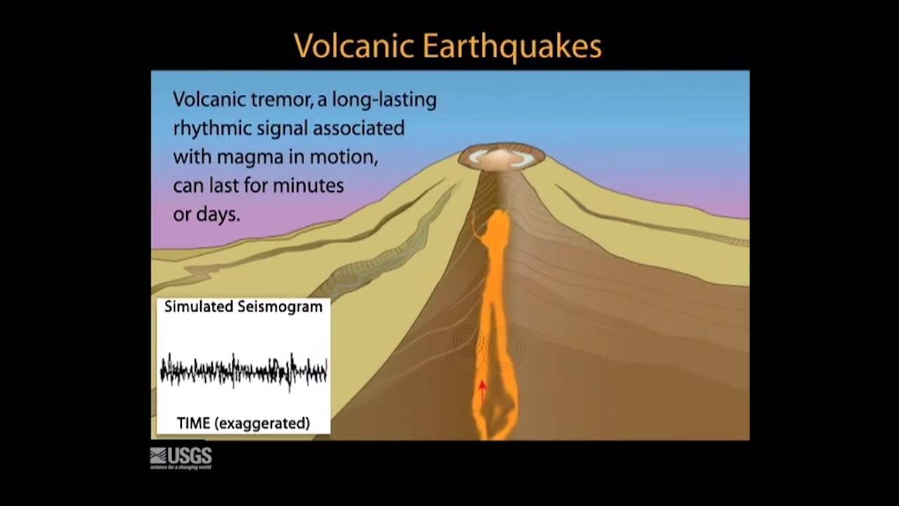
Tremors

Slide 16
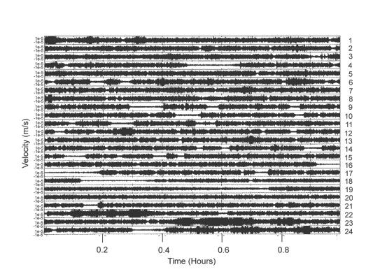
Continuous volcanic-seismic signals or tremors
Volcanic tremor at Bromo volcano (Indonesia) during a high activity phase at the end of 1995.
Large tremor amplitudes correlate with the eruption of heavy ash plumes while small tremor amplitudes appear during quiet steam emissions

Slide 17
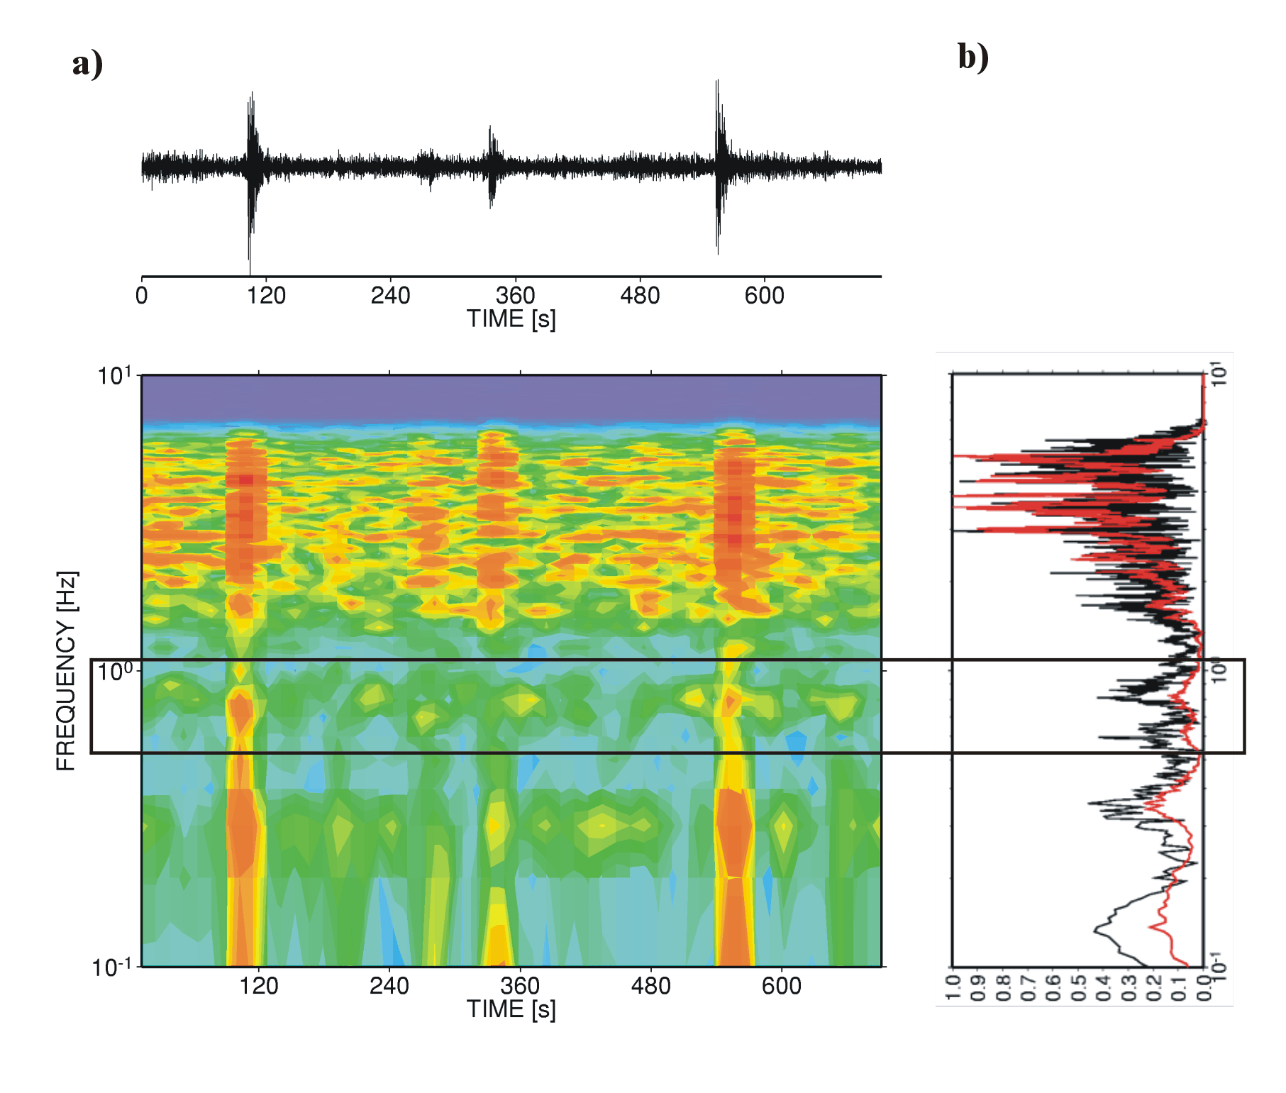
Low-viscous two-phase flow and eruption tremor
a) Explosion signals superimposed on the continuous signal of volcanic tremor at Stromboli volcano. The box marks the frequency band of weak but typical volcanic tremor band at Stromboli volcano.
b) The normalized Fourier transform of a explosion quake type signal (black) and of a noramalzed power spectrum of six hour continuous recording (red). The overall similarity between the explosion quake and tremor signal types is obvious.

Slide 18
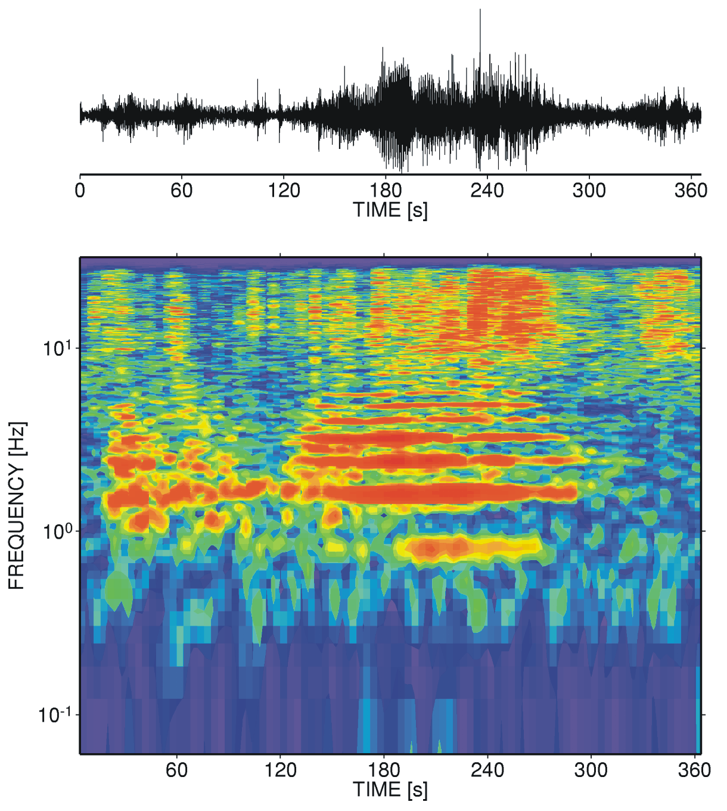
Volcanic tremor (high-viscous - resonating gas phase)
Harmonic tremor signal recorded at Mt. Semeru, Indonesia. Up to six overtones can be recognized starting with a fundamental mode located at roughly 0.8 Hz.

Slide 19
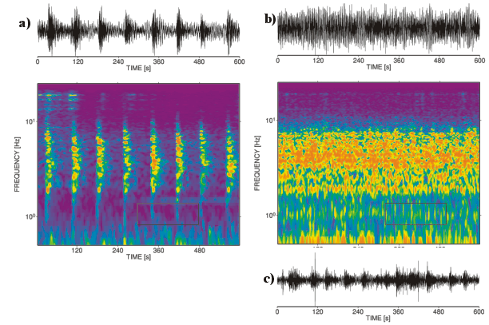
Sequence of repeated seismic signals at Mt. Merapi volcano in 1996.
a) Very regularly timed events before they merge together to form volcanic tremor (see b).
c) After some hours the tremor is replaced by a sequence of discrete events with slightly higher amplitudes than before.
Seems that merged events are causing the volcanic tremor.

Slide 20
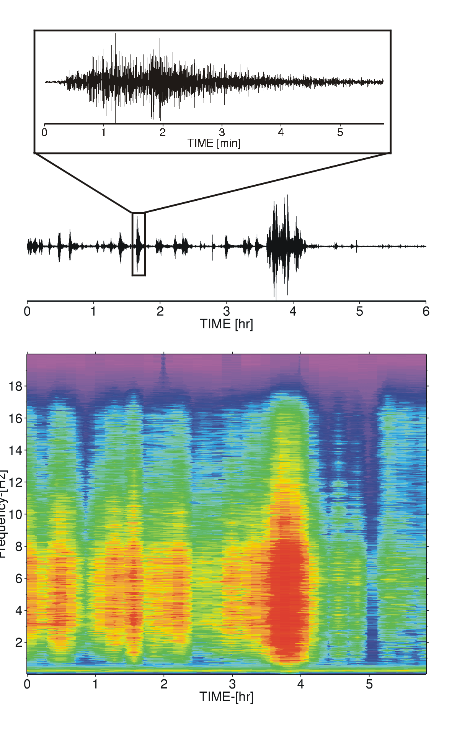
Surface processes
Sequence of medium to larger pyroclastic flows recorded at Mt. Merapi volcano during the 1998 dome collapse
Just before 4 hours, the largest pyroclastic flow in the whole eruption sequence takes place and lasts for about 30 minutes.
Note the 6-hour time scale and that individual events last many minutes, longer than the seismograms of typical earthquakes.

Slide 21
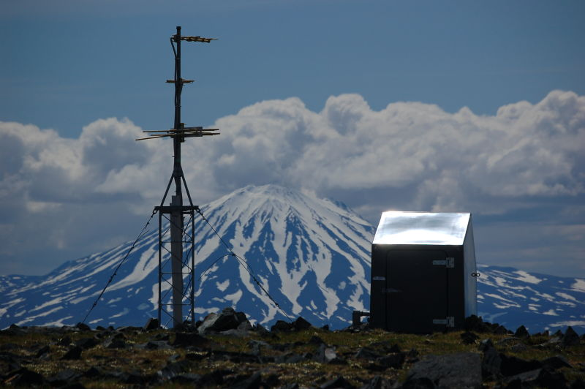
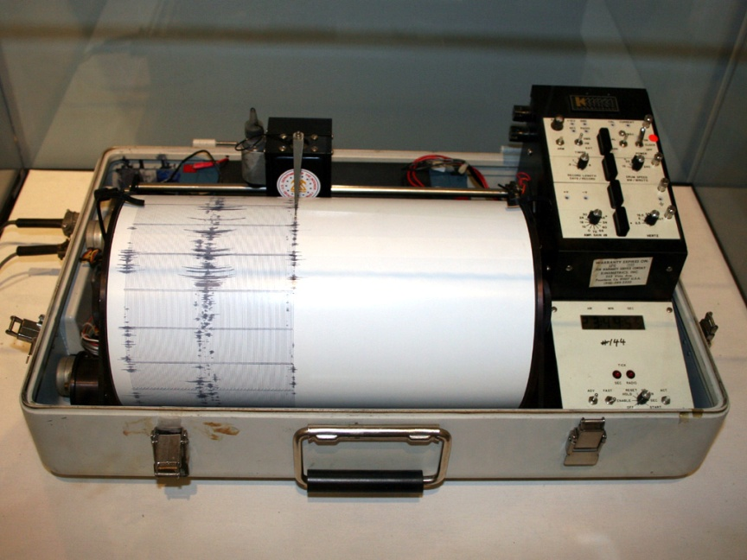
Seismic instrumentation
Single short period stations
Network of short period stations
Broad band stations
Sesmic array
Temporary stations

Slide 22
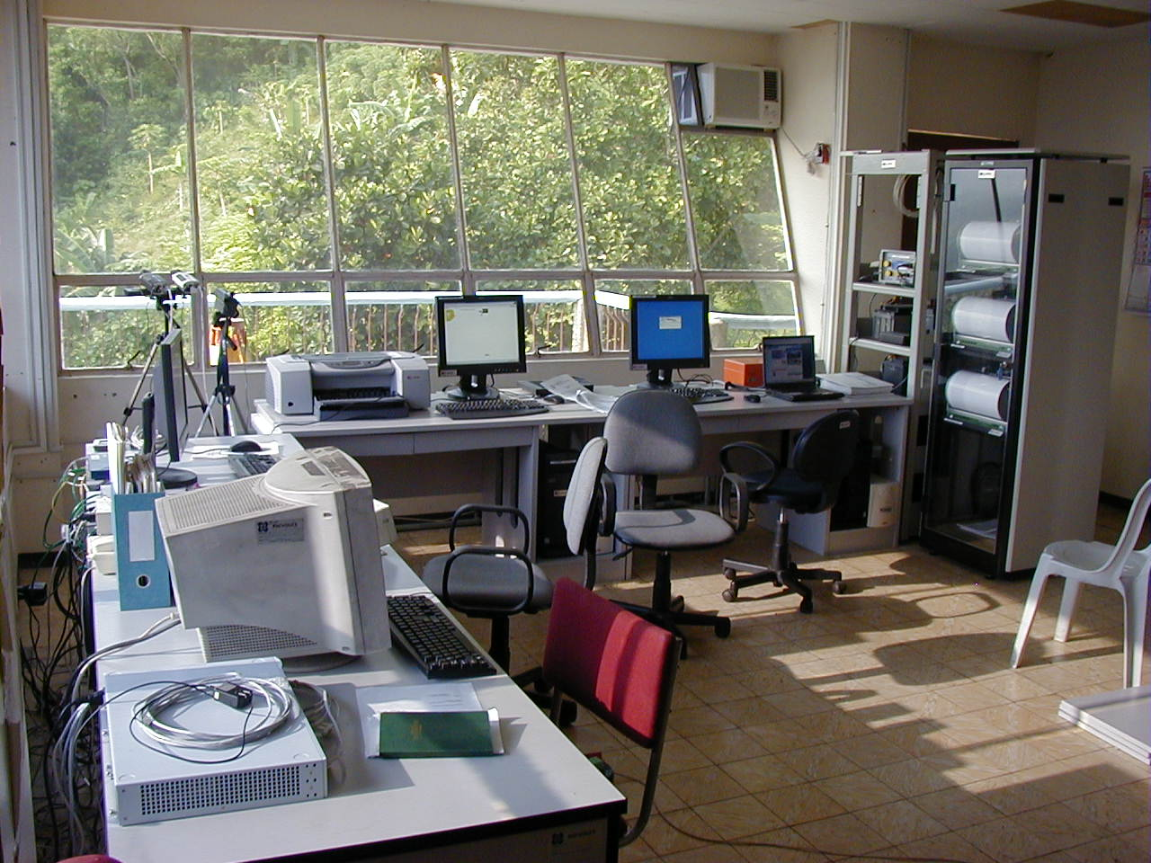
Small volcano observatory
Data receiving center (Lignon Hill) for Mayon Volcano seismic network, Phillipines

Slide 23
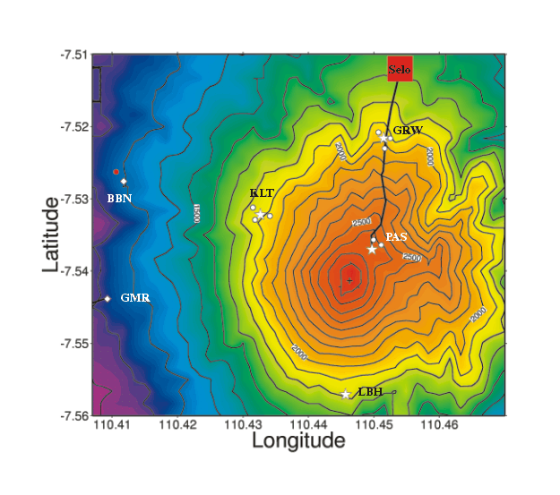
Example of a combined seismic array/network approach at Mt. Merapi volcano.
The stars show the location of broadband seismometers, whereas the circles mark the position of three-component short-period seismometers, in total forming three small-aperture arrays.
The diamond symbols show the location of seismic acoustic stations (short-period sensors with a microphone array).

Slide 24
Array design
Each array should consist of one three-component broadband seismometer as central station surrounded by three to six short-period, vertical-component seismometers .
Distance between array stations depends on the desired coherence band of the signals (how similar they are).
Ideally, the stations should be roughly 100 to 200 m apart from each other.

Slide 25
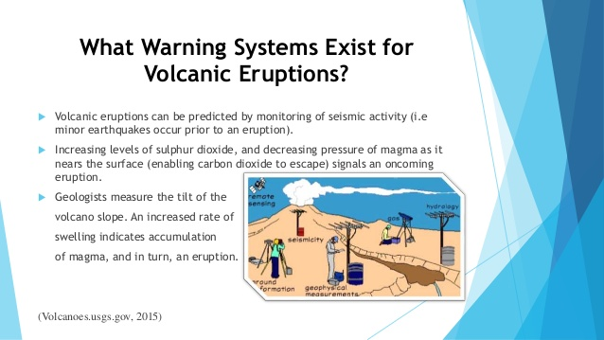

Slide 26
Seismic analysis and warning
Watch the seismograms for events
Count events
Spectral analysis
Real-time seismic amplitude measurements (RSAM)
Migration of hypocenters
Others more sophisticated

Slide 27
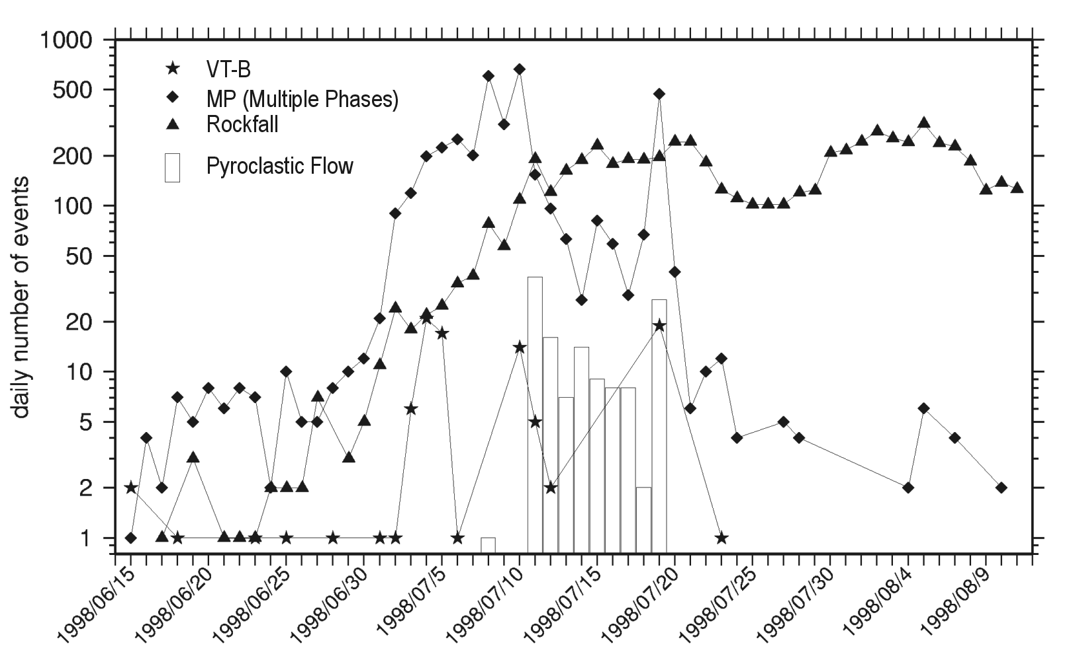
Count events
Event-type per day plot during the high activity of Mt. Merapi during July 1998. Note the increase of the three event classes before the onset of the first pyroclastic flow. Also note the similarity of the VT-B type event curve to the occurrence of pyroclastic flows.

Slide 28
Real-Time Seismic Amplitude Measurement (RSAM)
RSAM was designed for analog telemetry and consisted of an A/D converter, averaging of the seismic signal in 1 min or 10 min intervals and storing of the reduced data on the computer:
T is the averaging interval (originally 1 or 10 min) and s(t) the sampled seismic trace.

Slide 29
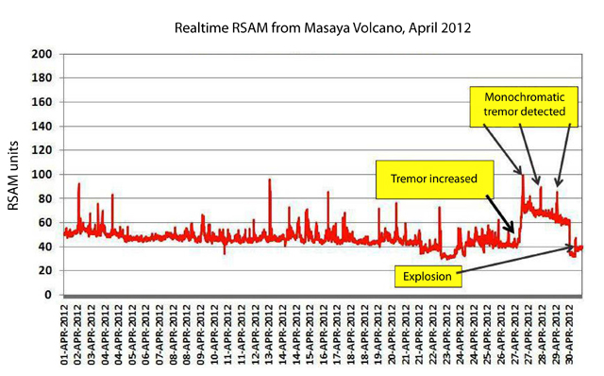
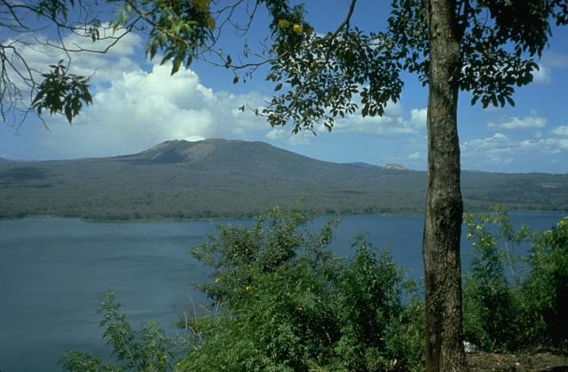
RSAM from Masaya volcano, Nicaragua

Slide 30
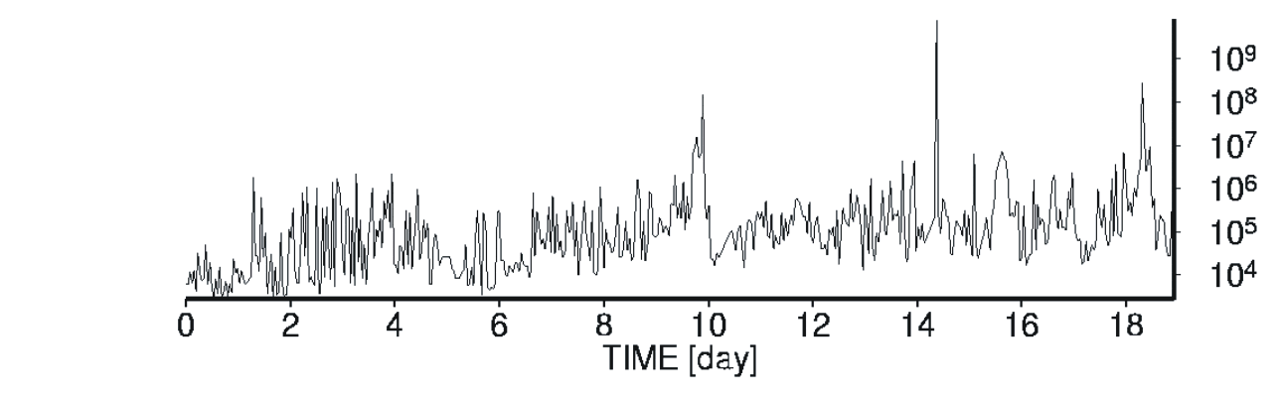
Spectral analysis
The total power calculated in the frequency band between 0.6 - 3.0 Hz from 01 - 19th July 1998 at Mt. Merapi.
Two of the visible peaks (i.e., day 9 and day 18) are associated with pyroclastic flows, while the sharp peak visible at day 14 is caused by an regional earthquake.

Slide 31
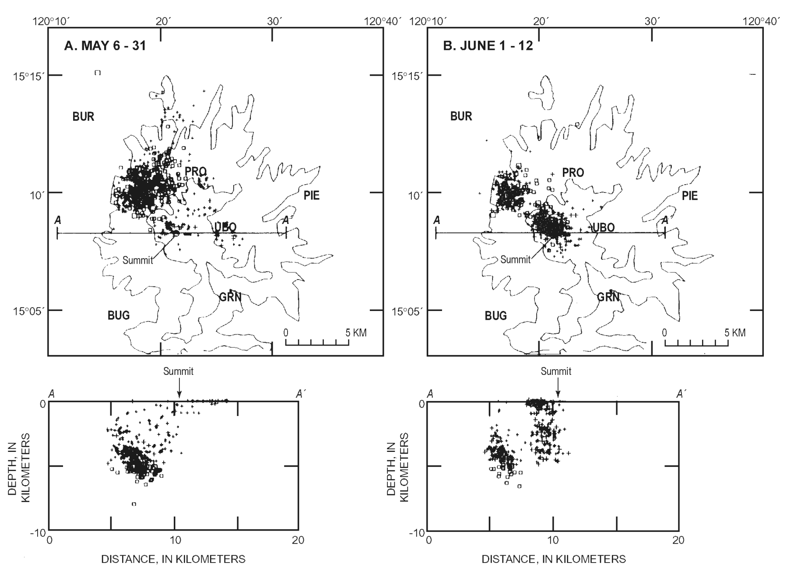
Movement of hypocenters
Mt. Pinatubo seismicity during May 6 to May 31. The seismic events are clearly clustering northwest of the volcanic center.
Shows the seismicity between June 1 to June 12 indicating a shift of the hypocenters to shallow depths and closer to the summit of Mt. Pinatubo

Slide 32
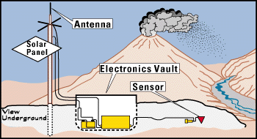
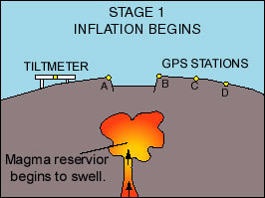
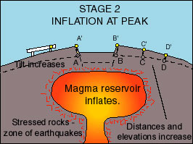
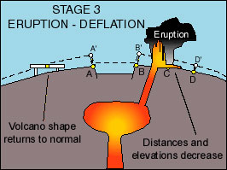
Hawai monitoring

Slide 33
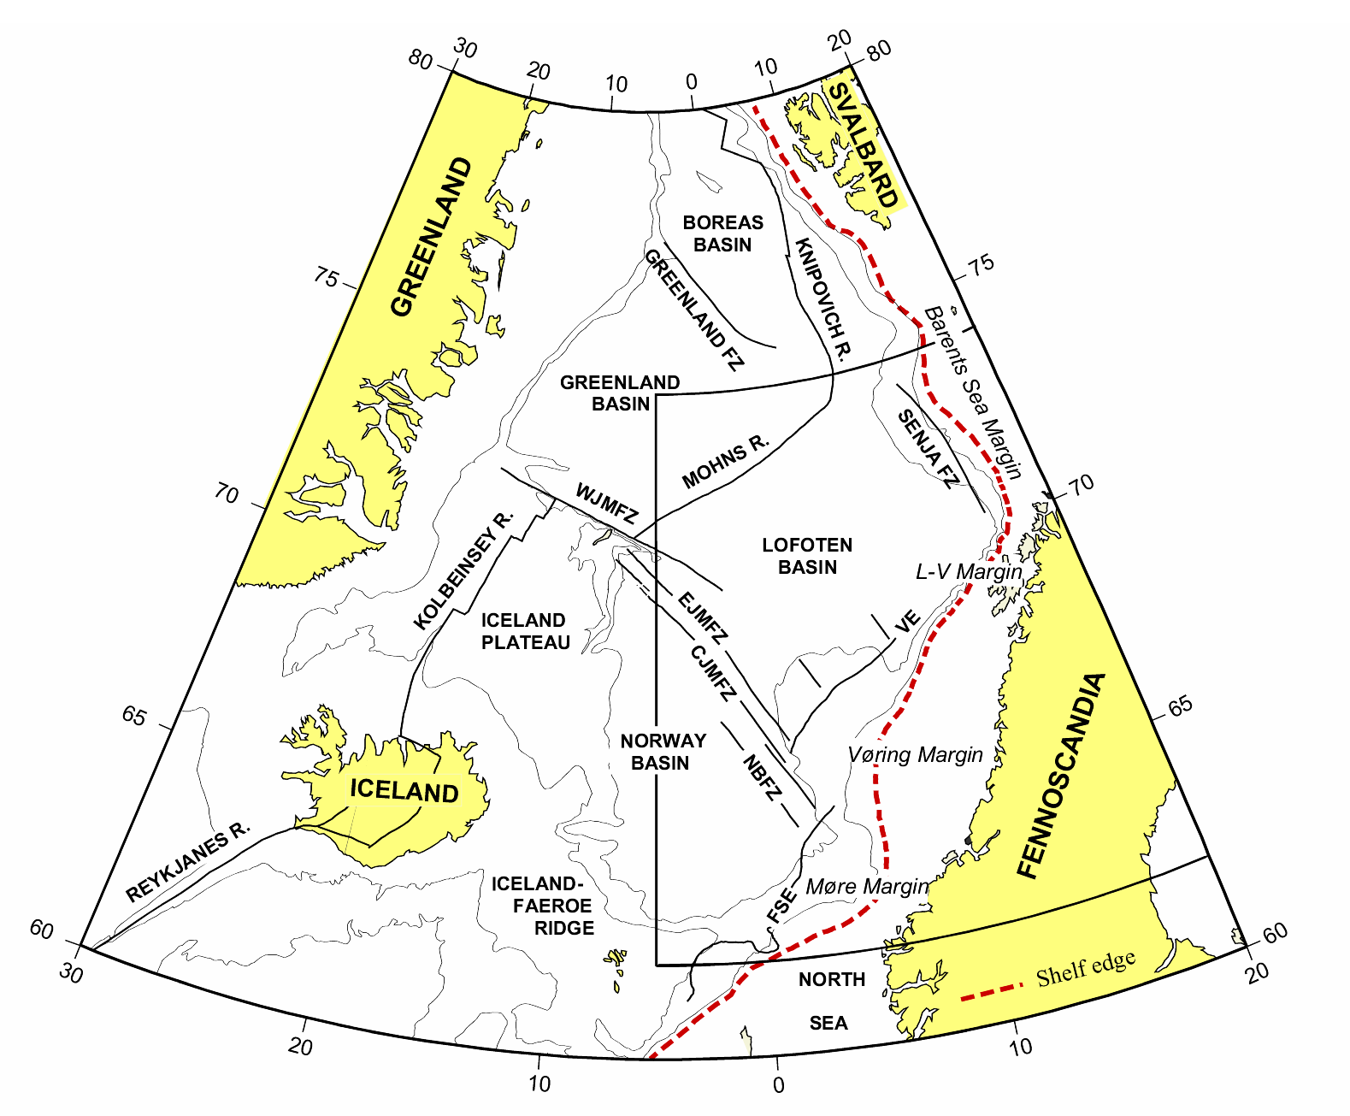
Jan Mayen in the North Atlantic
Jan Mayen
Jan Mayen island is situated between the two main spreading ridges along the North Atlantic.
It has the world’s northernmost volcano
Spreading along these two main ridge systems is slow at a rate of 15-17 mm/year.
Jan Mayen is also at the northern end of the Jan Mayen fracture zone, possibly a micro-continent.

Slide 34
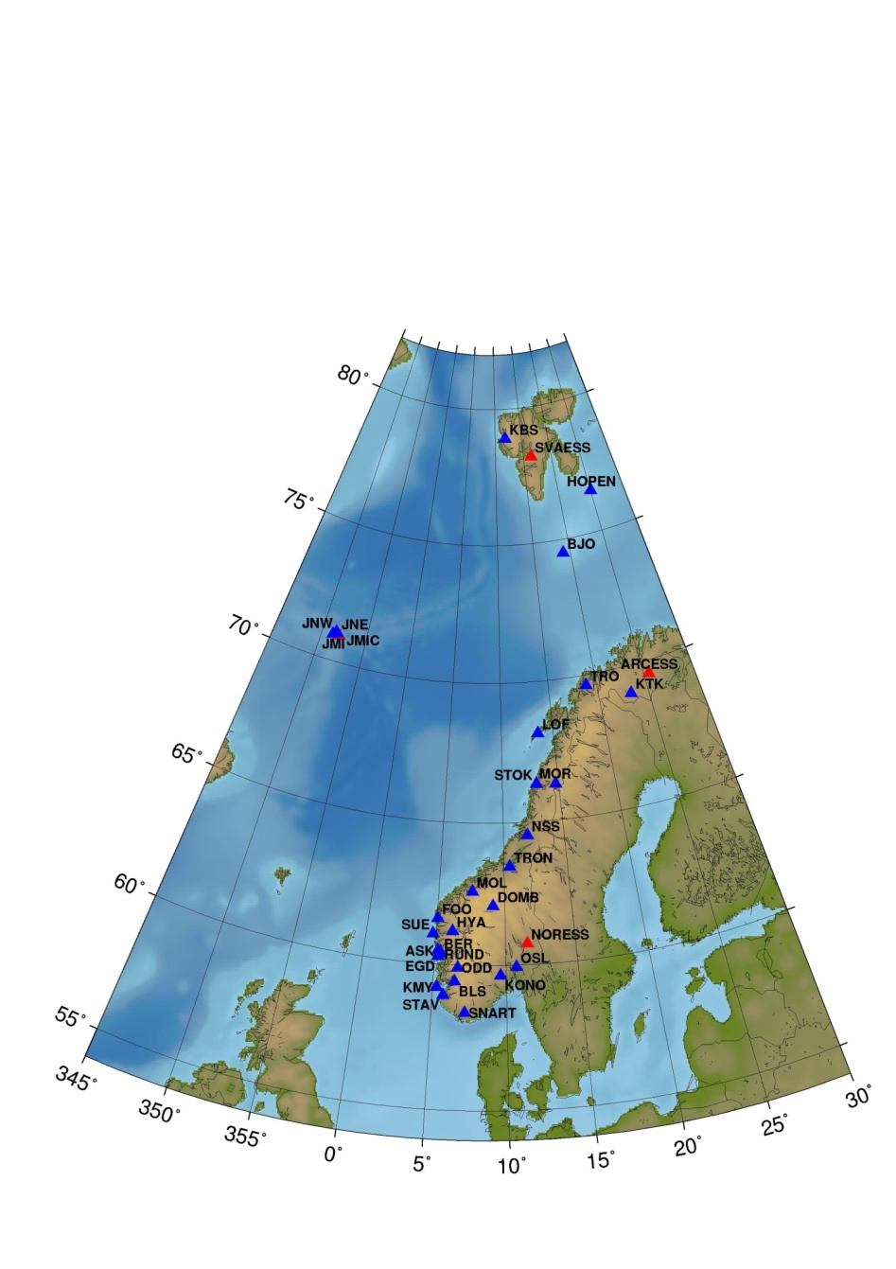
Norwegian National Seismic Network
Seismic stations in Norway. Blue symbols are stations in Norwegian National Seismic Network, and red symbols are NORSAR arrays. Station JMIC is a CTBTO station operated by NORSAR
Jan Mayen stations

Slide 35
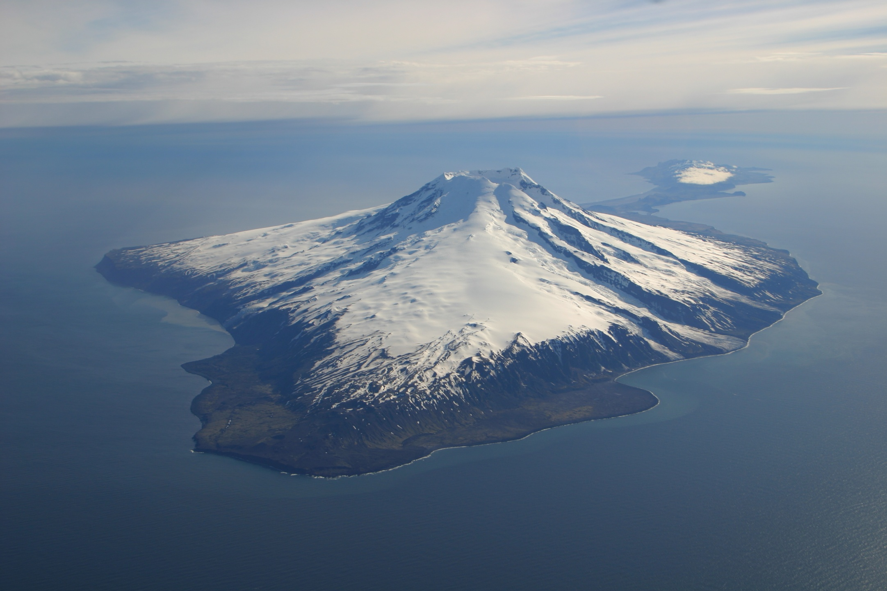
North Jan Mayen

Slide 36
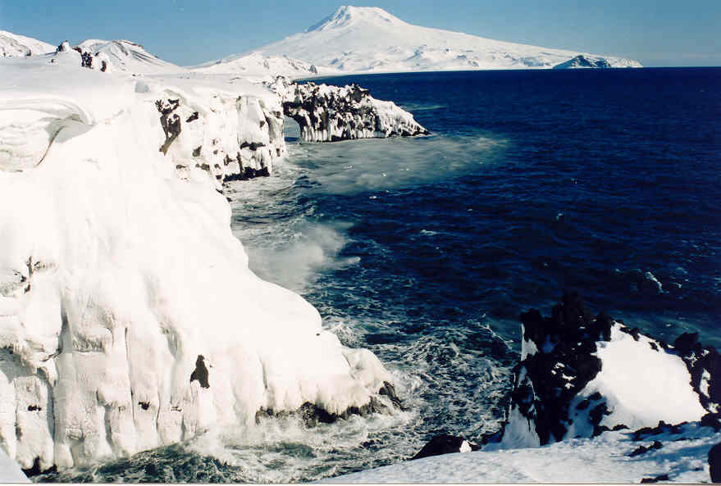
Beerenberg and Eggøya

Slide 37
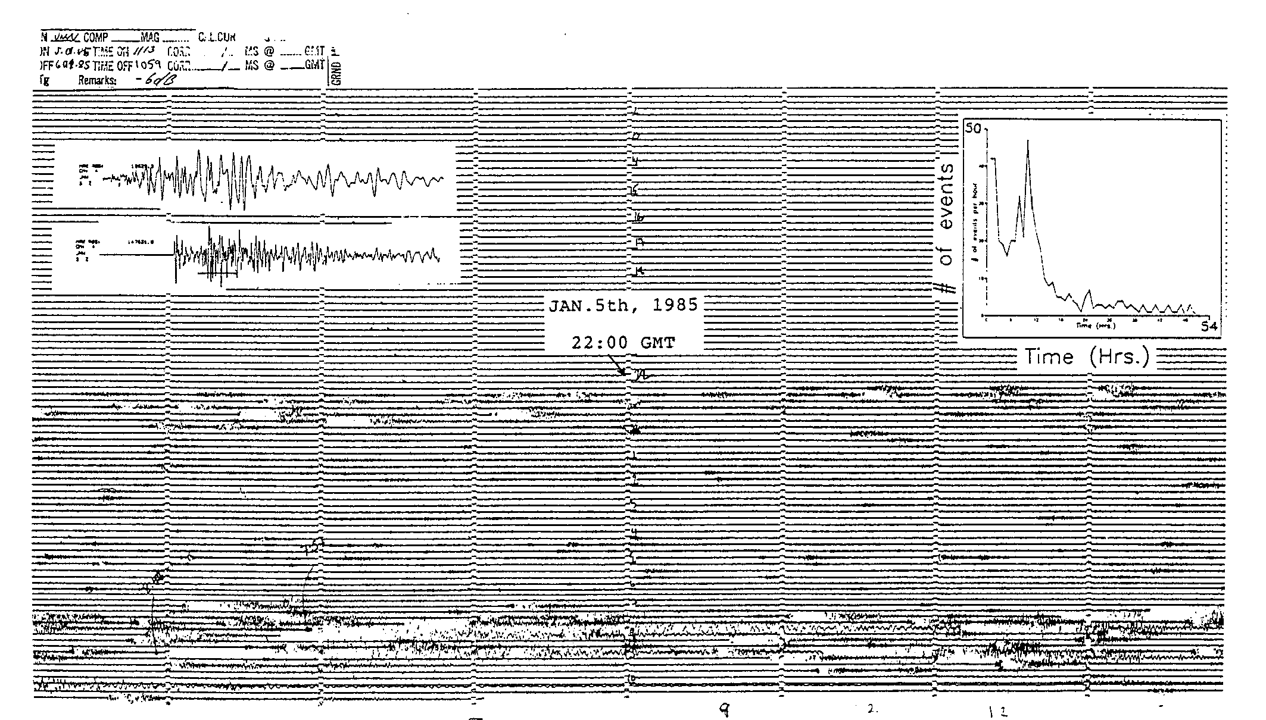
Seismogram of 1985 eruption predicted the eruption by 10 hours

Slide 38
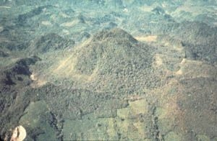
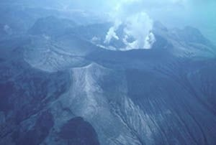
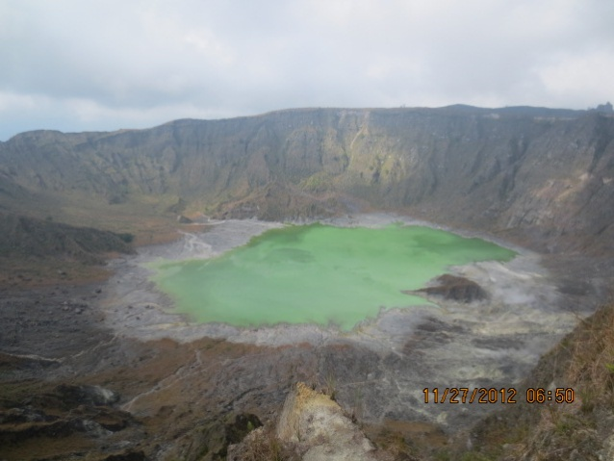
Chichon, Mexico March 28, 1982
Before
After
Past El Chichon Eruptions
1360 ± 100 years, 1190 ± 150, 780 AD ± 150, 590 AD ± 100, 480 AD ± 200, 190 AD ± 150, 20 BC ± 50, 700 BC ± 200, 1340 BC ± 150, 2030 BC ± 100, 6510 BC ± 75.
The 1982 eruption of El Chichón is the largest volcanic disaster in modern Mexican history killing more than 2000 people

Slide 39
Eruption could have been predicted
With more than 600 years since the last major eruption of El Chichón, few people were aware of the volcanic risk. Most presumed it to be a dorment volcano or extinct.
However, there was a seismic network in the area monitoring dam induced seismicity and increased seismicity was observed during all of March
But
The operator of the network were not aware of what the seismicy indicated
The National University of Mexico scientists visited in the beginning of every month, howevet this was too late for this erupetion.

Slide 40
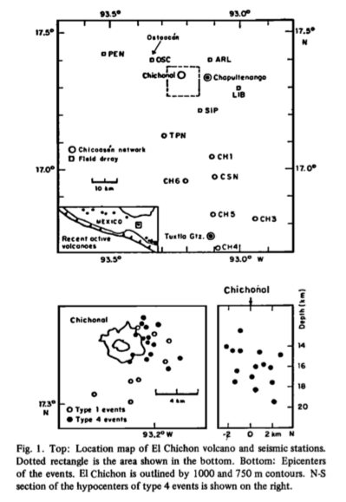
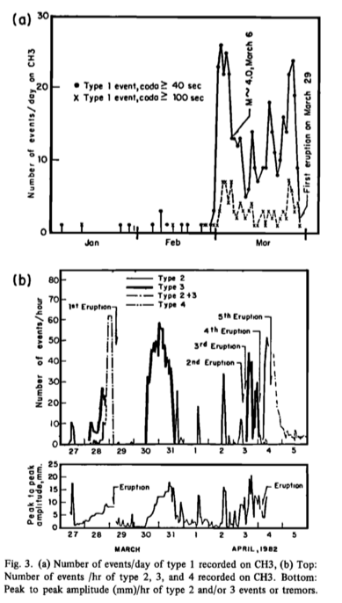
Seismic
network
Number
of events/day

Slide 41
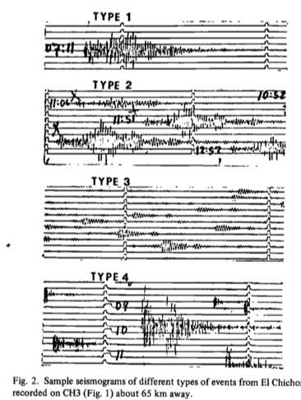
Event types at El Chicon
A sample seismogram of different types of events form El Chicon, distance from volcano is 65 km.

Slide 42
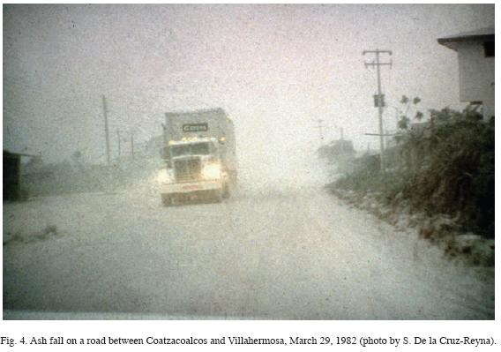
Heavy ash fall, 100 km away

Slide 43
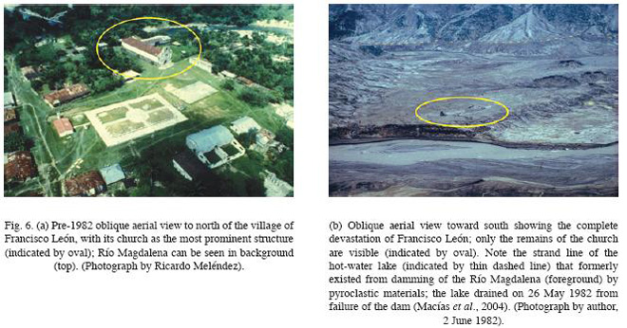
Local village of Francisco Leon, at 7 km distance, was destroyed
From 29th March to 4th April 1982 three large explosive eruptions occurred at El Chichon volcano. The second one destroyed the village

Slide 44
Conclusion
Seismic monitoring is the simplest and cheapest way of predicting future volcanic erupetions and following the activity of a volcano.
Seismic monitoring should be complented by other monitoring methods.

