Slide 1
Seismic phases and earthquake location
Jens Havskov

Slide 2
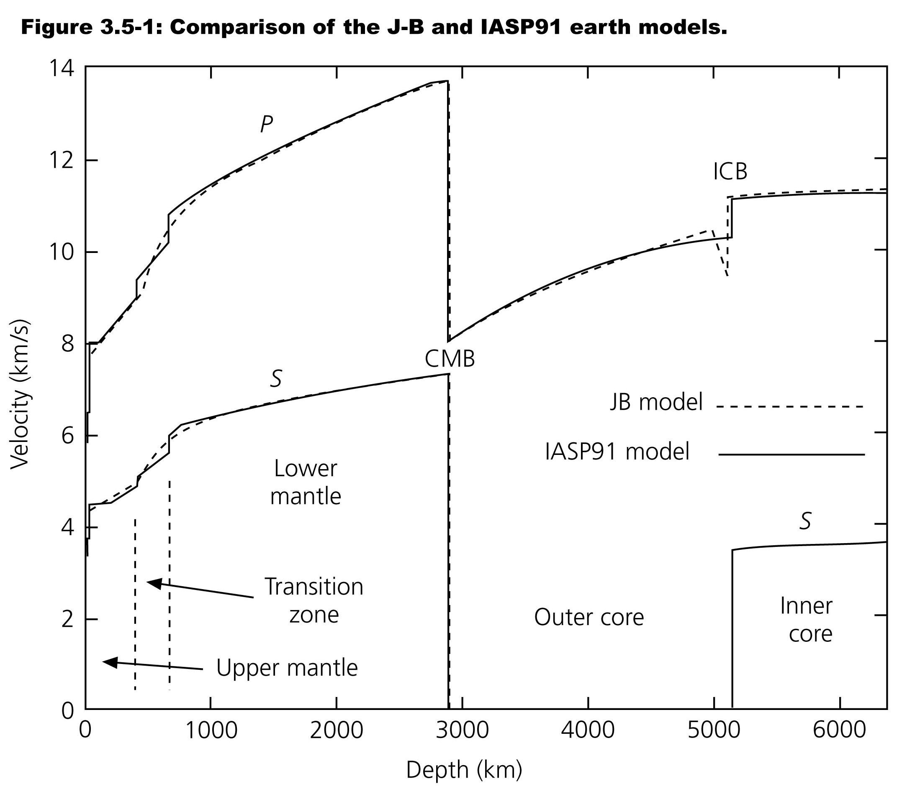
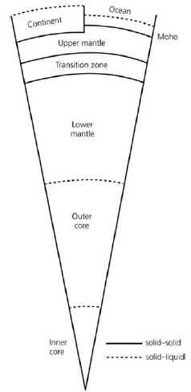
Earth structure

Slide 3
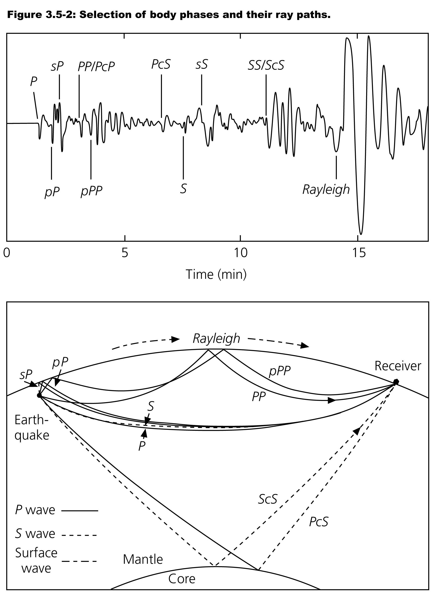
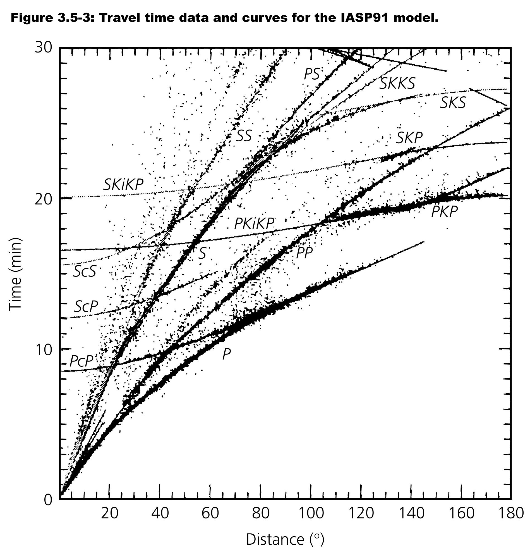

Slide 4
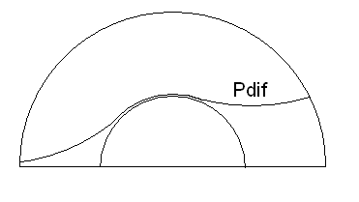
The Pdiff phase around the core-mantle boundary

Slide 5
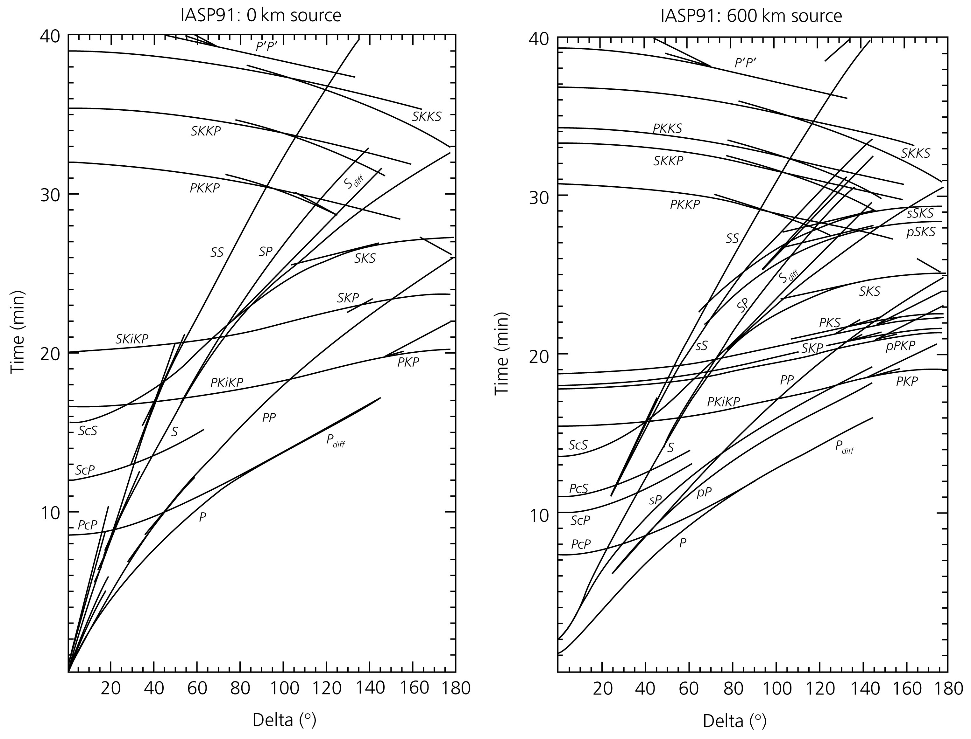
Global travel time curves
Travel times for body waves using the IASP91 model. Delta is distance in degrees. To the left is shown travel times for a surface focus and to the right travel times for a focal depth of 600 km. Figure from Stein and Wysession (2003)

Slide 6
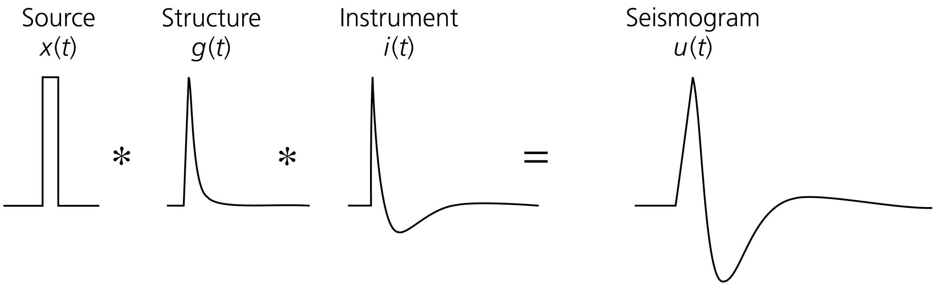
Seismogram as a function of source, structure and instrument
The eartquake is assumed to happen instantaneous

Slide 7
Earthquake source
For a small earthquake the source can be considered an instantaneous rupture on a fault.
For a large earthquake, the rupture starts in one end and propagates along the fault with the rupture velocity.
Rupture
starts
here
Rupture propagates in direction of arrow
If the fault is 600 km long and the rupture velocity is 3 km/s, then the shaking will be felt for 200 sec. Or we can say the earthquake lasts 200 sec.

Slide 8
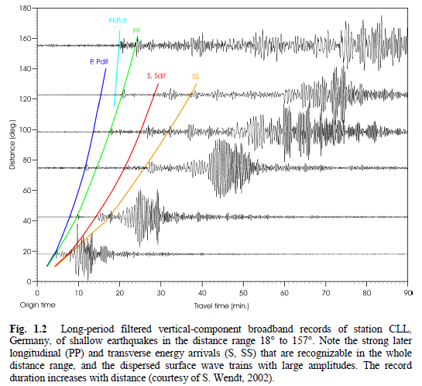
Example of teleseismic seismograms

Slide 9
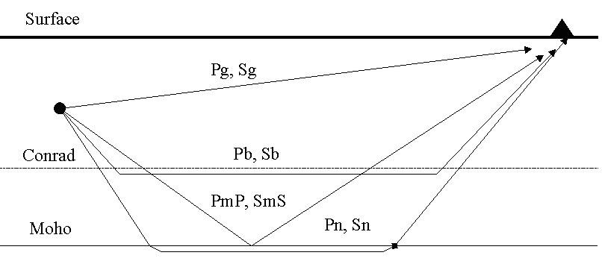
Local layered model
A simplified model of the crust showing the most important crustal phases observed at local and regional distances

Slide 10
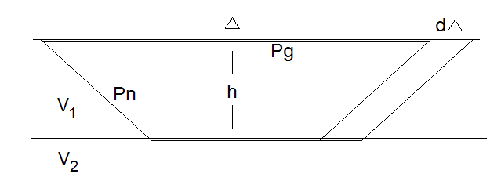
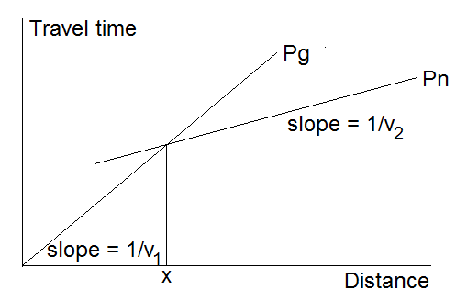
Travel times for two layer model

Slide 11
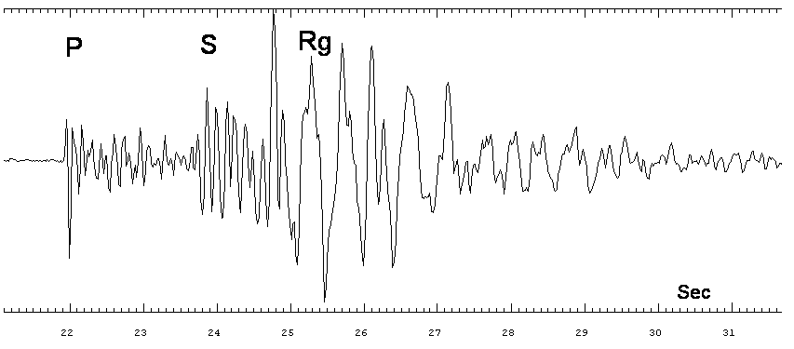
Explosion, 16 km, ML=0.6
Rg is a surface wave at very short distances. When observed, it indicates that the souce is at the surface.

Slide 12
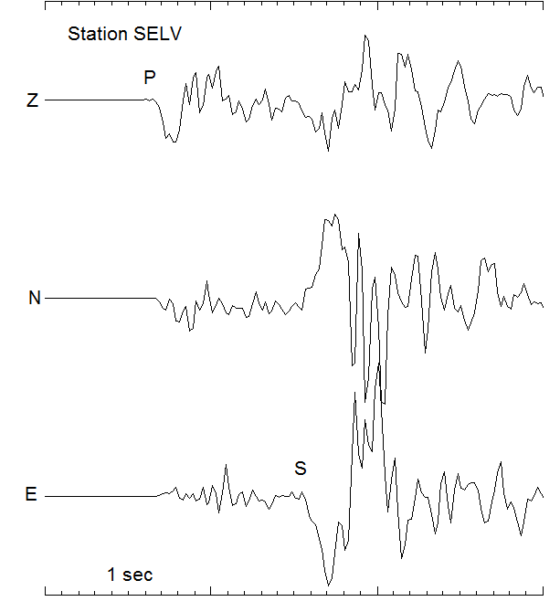
Local earthquake, distance 6 km, depth 2.5 km, ML=3.4

Slide 13
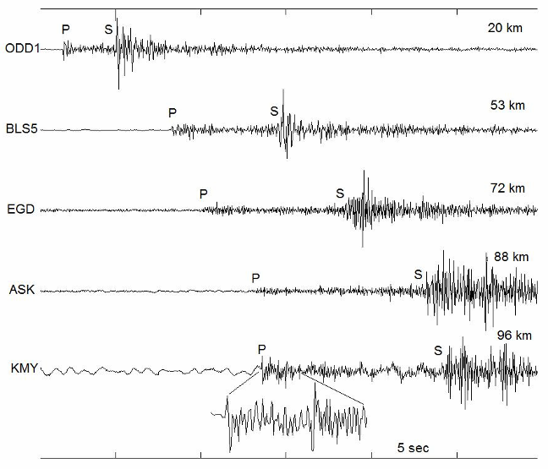
Local earthquake, ML=1.5

Slide 14
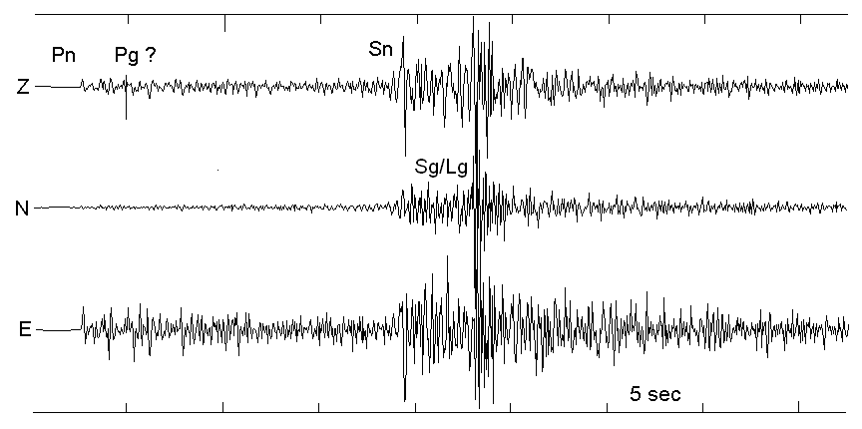
Local earthquake, 149 km, ML=3.3
Lg is a high frequency (1 Hz) surface wave at regional distances

Slide 15
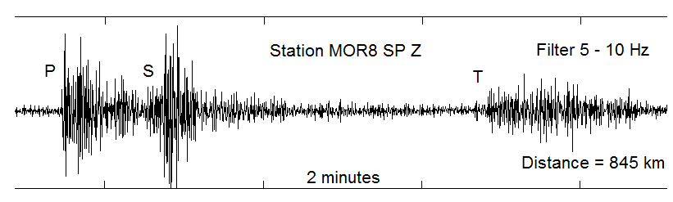
T-wave recording, ML=4.7
T-waves are sonic waves trapped in the SOFAR (Sound Fixing And Ranging) channel in the ocean and traveling with the velocity of P-waves in water, 1.5 km/s
Earthquake on the Mid-Atlantic ridge in the Greenland Sea recorded on the west coast of Norway. The signal is filtered 5-10 Hz.

Slide 16
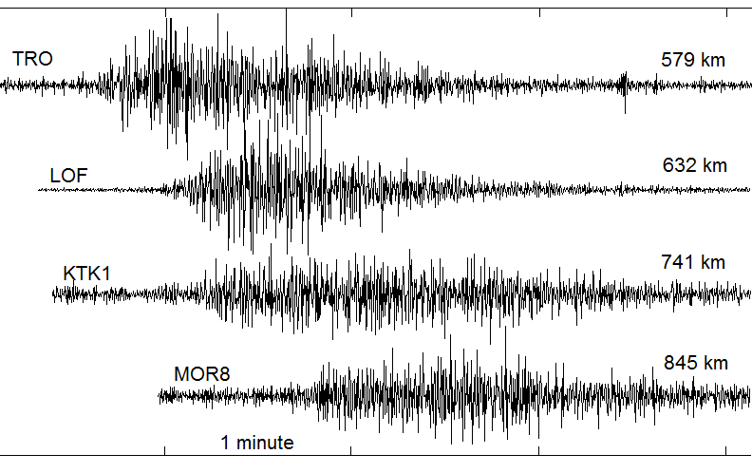
T-waves?
If only T-waves are detected, they are hard to identify due to the low velocity

Slide 17
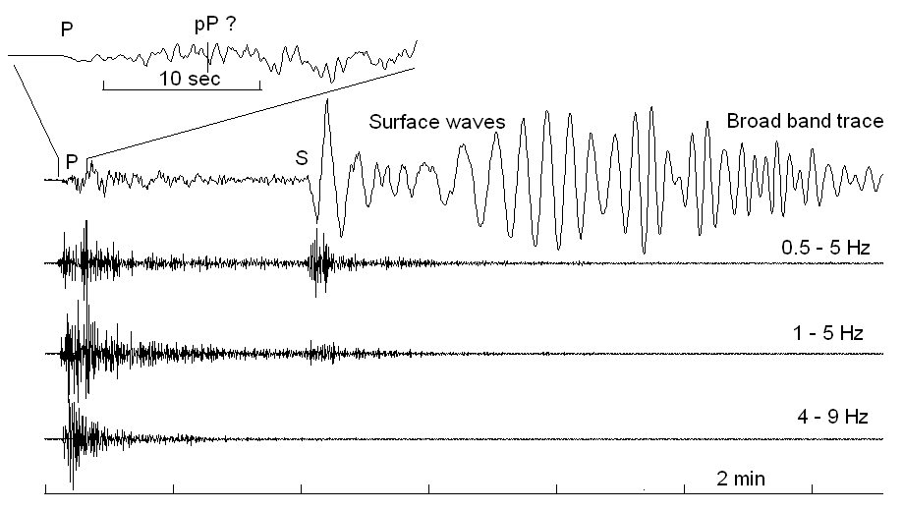
Regional earthquake, 2300 km, M=7.5

Slide 18
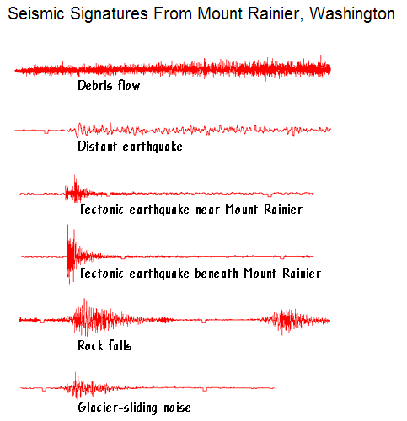
Signals from different kinds of seismic sources
Based on nearly 30 years of seismic monitoring, the seismic signatures above represent the most common events that cause the ground to vibrate at the volcano. The overall shape of each seismic signature is easy to see by comparing the amplitude (height of waveform), frequency (width from peak to peak within waveform), and duration (length of waveform) of each signature. The "tic" marks on each signature represent 1 minute in time

Slide 19
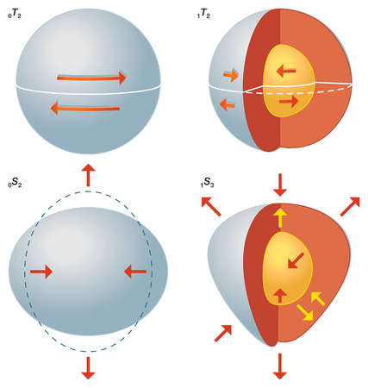
Free oscillations of the Earth
Longest oscillation period is 54 minutes. There are many higher mode oscillations.

Slide 20
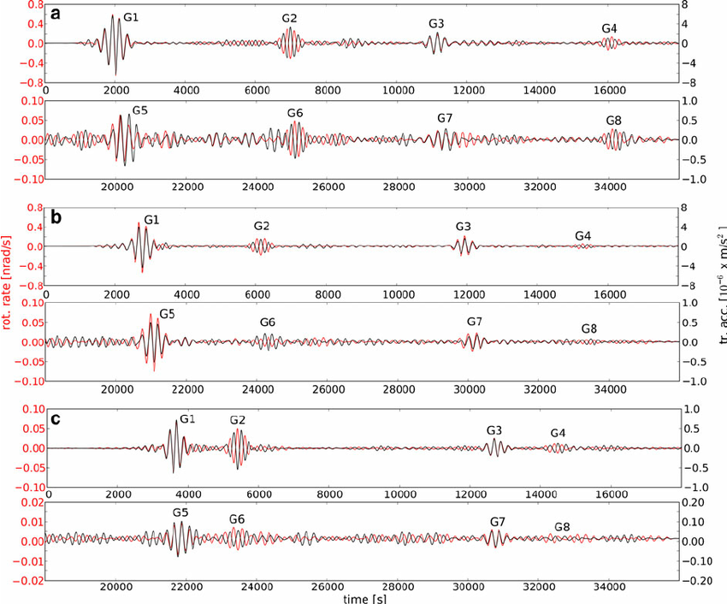
Seismogram of free oscillations

Slide 21
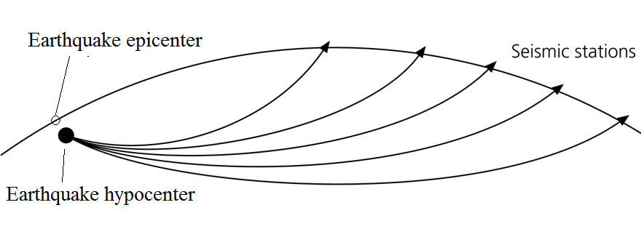
Earthquake location
An accurate location is important:
To define geological structures
In case of large earthques for rescue operations
The accuracy of the epicenter is between 1 and 50 km, typical 10 km. The hypocentral depth is often less accurate than the epicenter.
The time of the eartquake occurence is called the origin time which is also calculated.

Slide 22
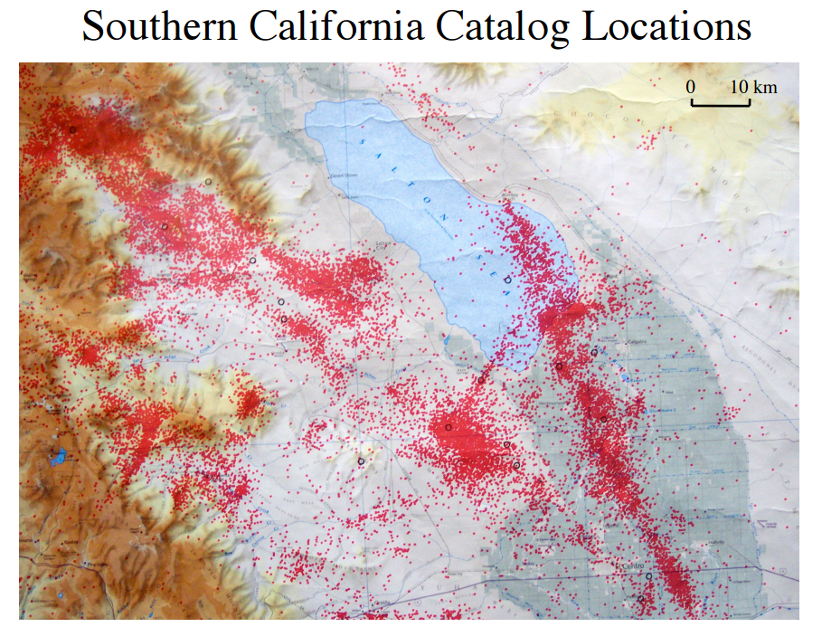

Slide 23
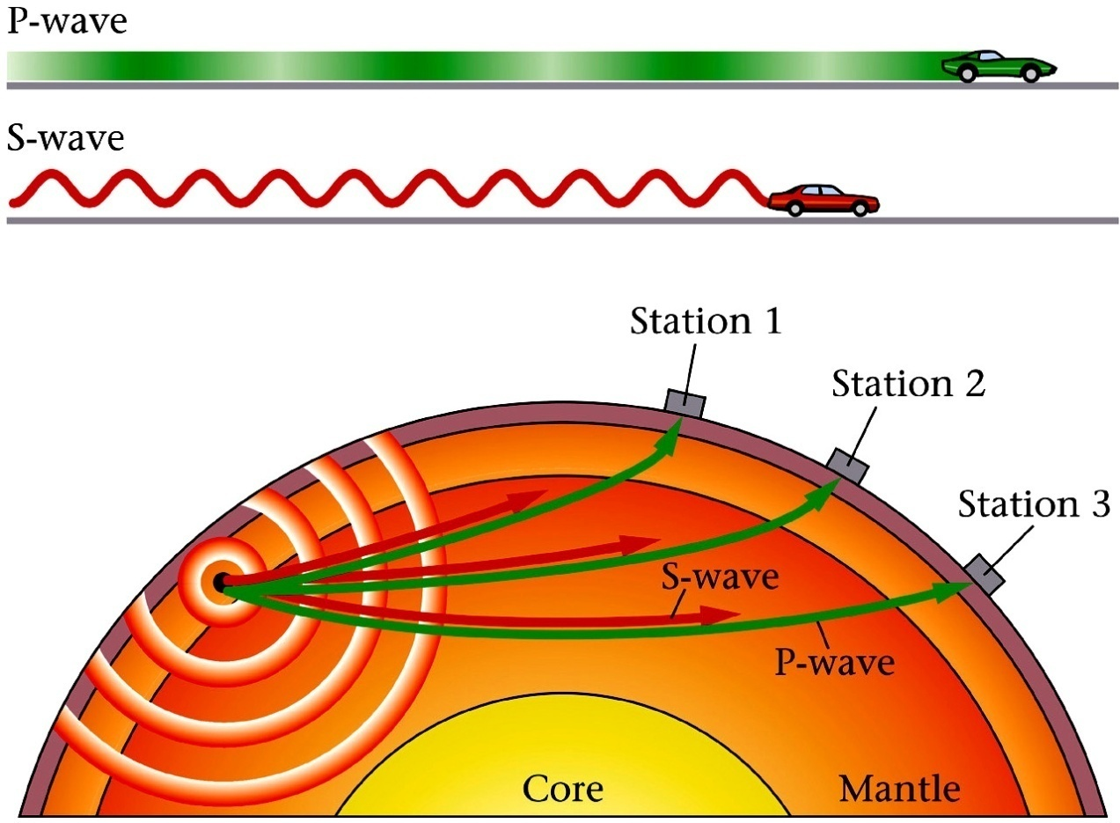
Locating earthquakes
Use that P and S-waves travel with different velocitites and use the time difference to calculate the distance.

Slide 24
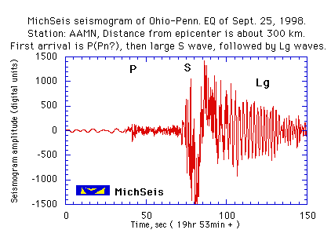
S-P time

Slide 25
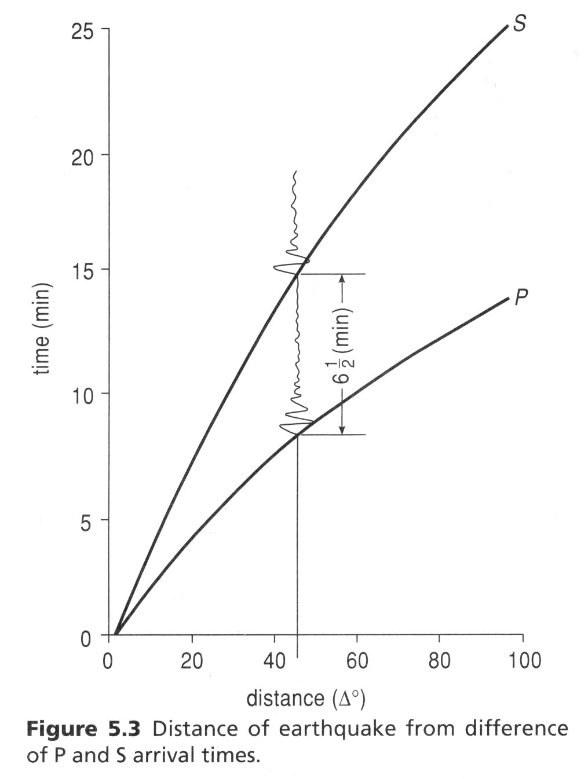
Distance to earthquake as a function of S and P travel times, example of global earthquake

Slide 26
Three station location
One station gives an infinite number of locations around the circle
Two stations give 2 possible locations
Three stations give, in theory, only one location
In reality there is always error

Slide 27
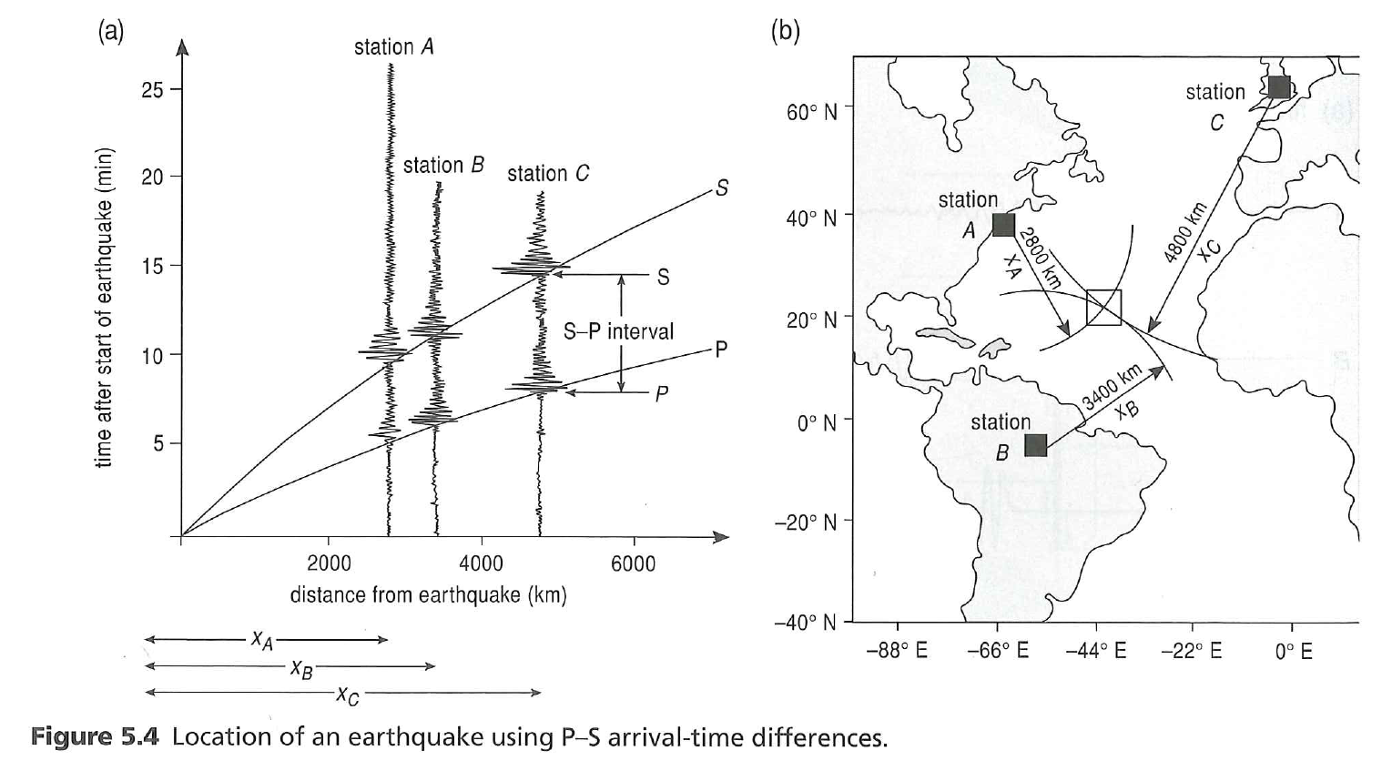
Global three station location using S-P

Slide 28
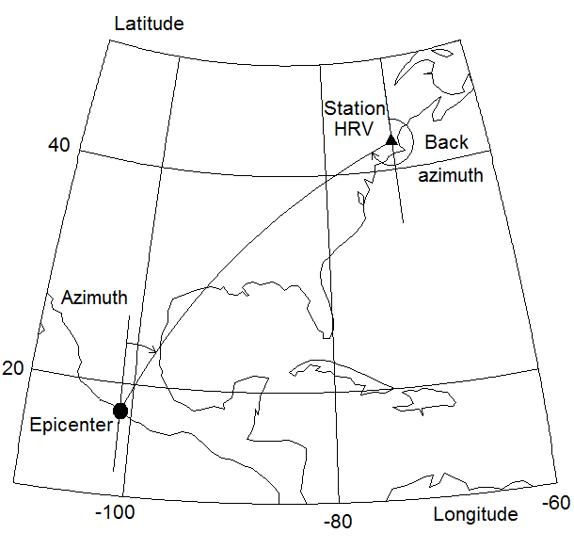
Definition: Azimuth and Back-Azimuth
Azimuth is 39 deg and back azimuth is 234 deg

Slide 29
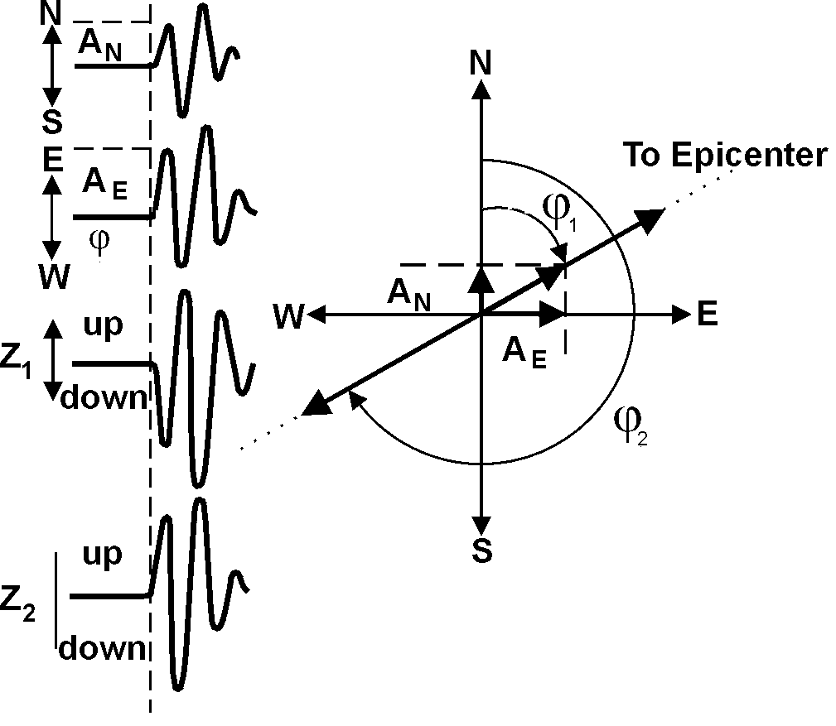
Single station location
Φ=arctan(A_{E}/A_{N})
Example of P-wave first motions in 3-component records from which the backazimuth φ can be derived. φ₁ corresponds to, in this example, a first motion down (Z₁) on the vertical channel and φ₂ to a first motion up (Z₂)

Slide 30
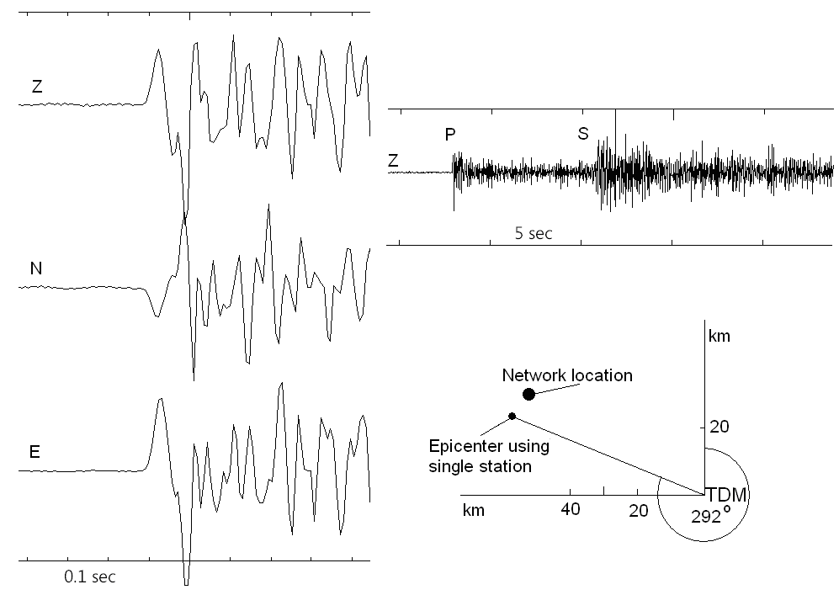
Single station location
Example of a three component recording and location by using the back azimuth. The station is called TDM.

Slide 31
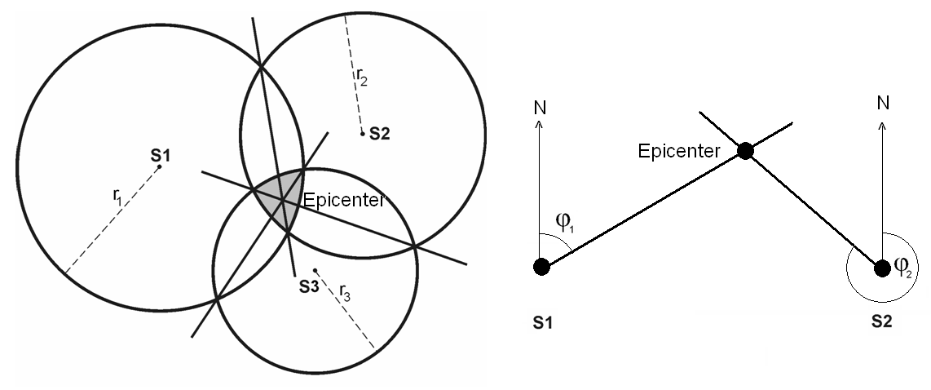
Multiple station location with error
Left: The stations are located in S1, S2 and S3. The epicenter is found within the shaded area where the circles overlap.
Right: Location by two stations and back azimuth.

Slide 32
Network geometry and error
The figure to the left shows 3 stations (S1, S2 and S3) almost aligned in the x-direction (left - right). The event has been located by using the distances to the 3 stations and the shaded area in the middle gives an indication of the area within which the epicenter can be found. The figure to the right shows the same situation except that an azimuth determination has been made with station S1 which limits the direction to which the epicenter can be located to within the angle shown and thereby makes the estimate of epicenter error smaller in the y-direction.

Slide 33
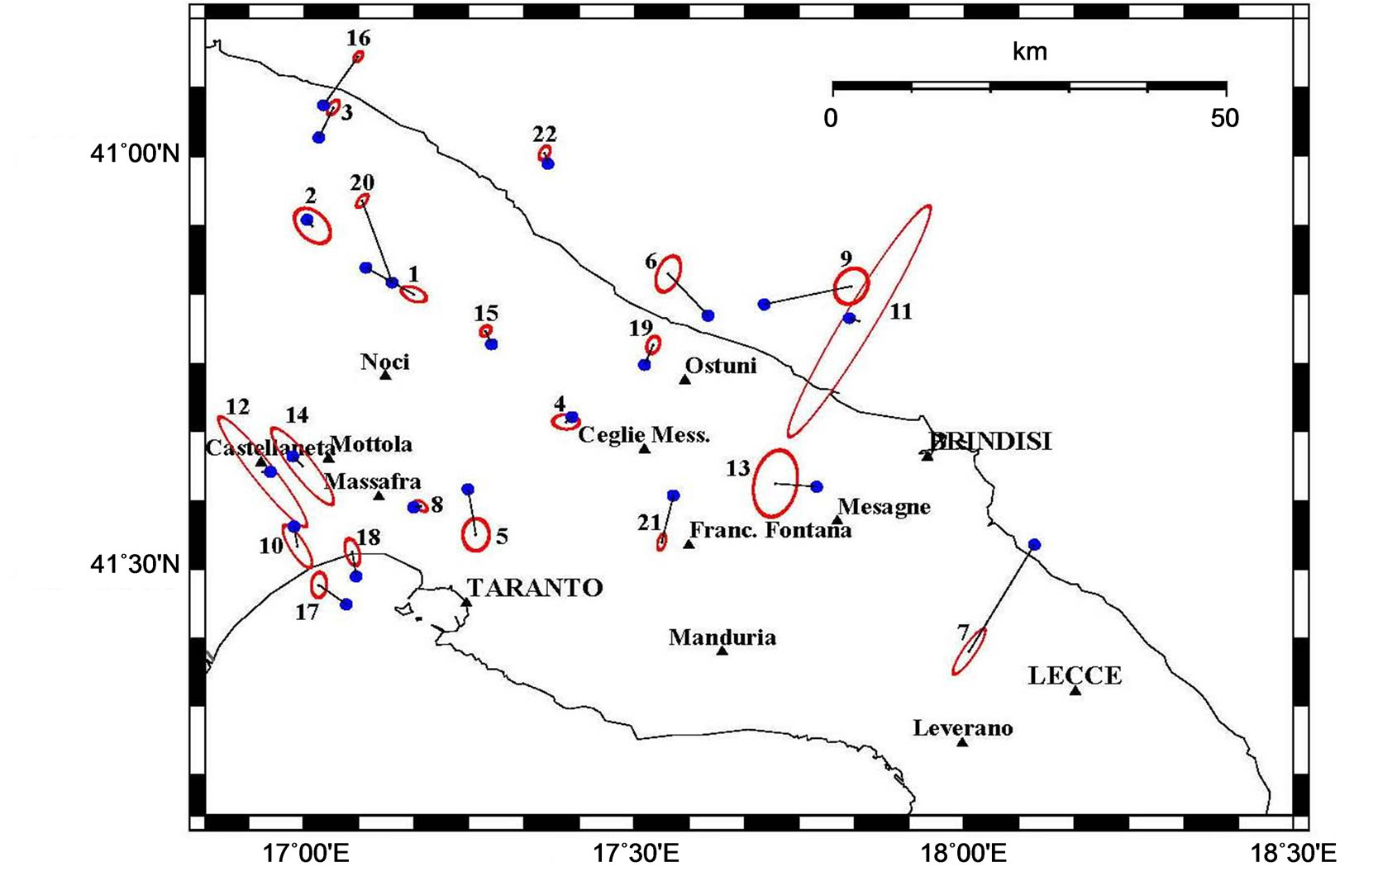
Example of calculated location errors
Compute programs will calculate errros in x, y and z, which can be plotted as error ellipses.

Slide 34
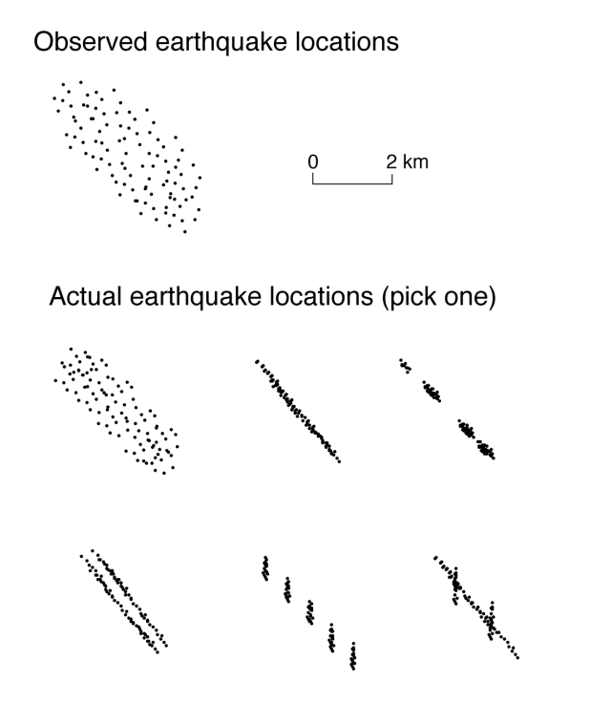
Real errors

Slide 35
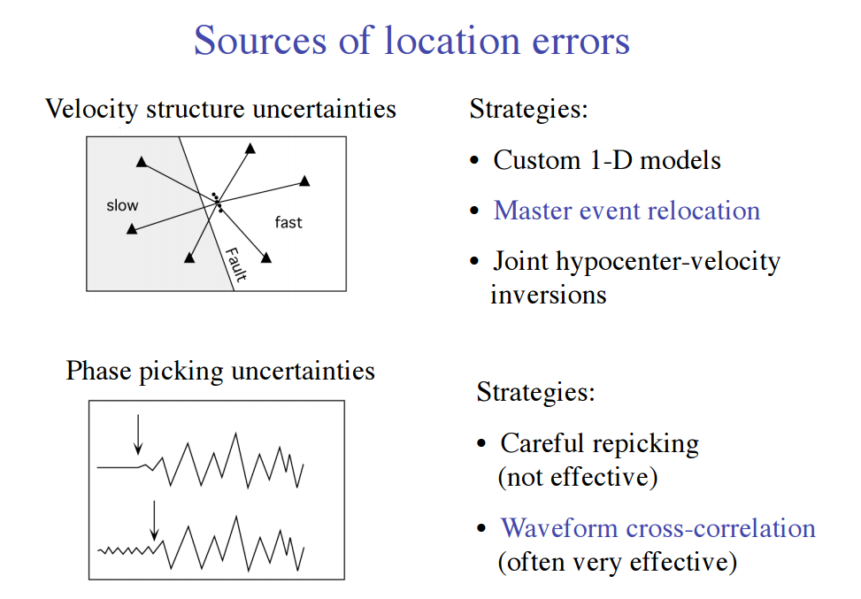

Slide 36
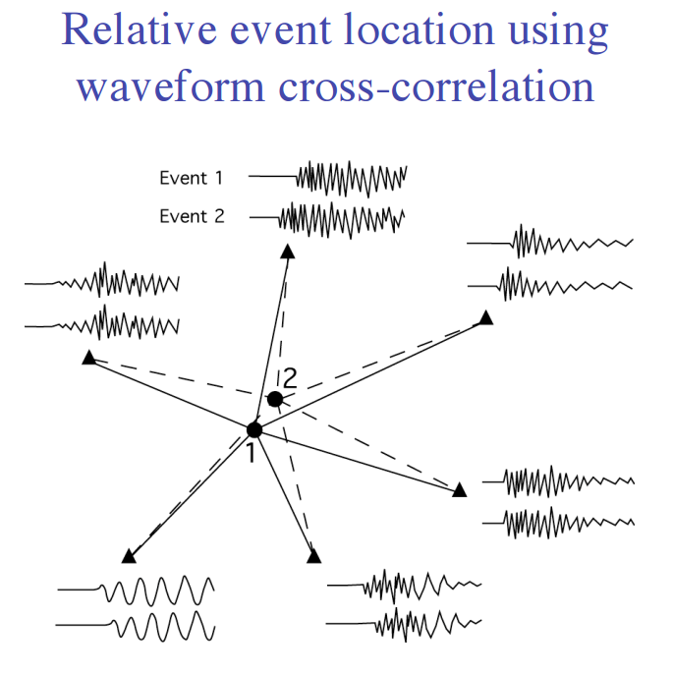

Slide 37
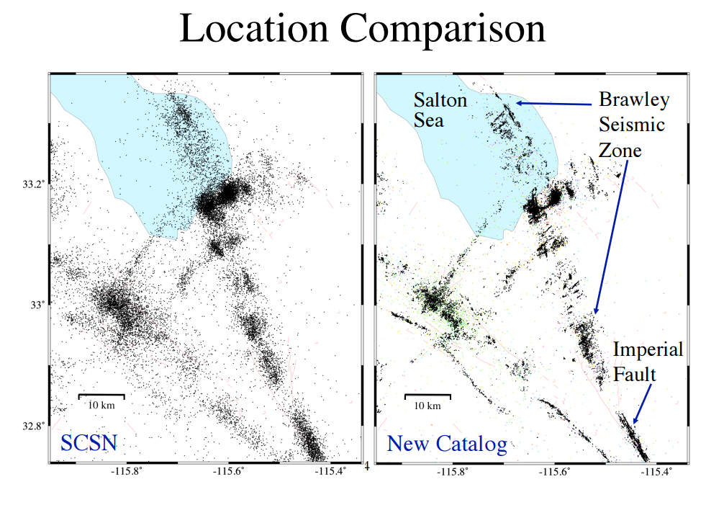

Slide 38
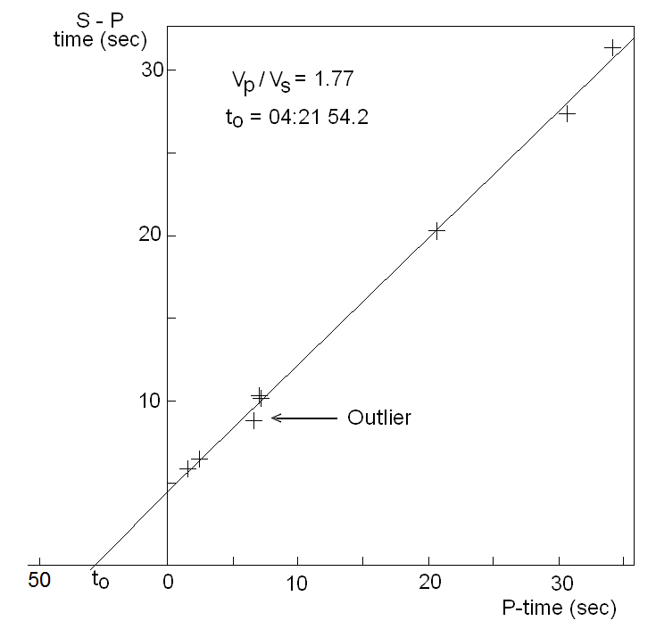
Wadati diagram for checking readings
An example of a Wadati diagram. The intercept on the x-axis gives the origin time. The slope of the line is 0.77 so the v_{p}/v_{s} ratio is 1.77. Note that the points do not exactly fit the line indicating model or observation errors. In particular one station has suspicious readings (marked with outlier).

Slide 39
Iterative location
Start with a test location, often the nearest station
Calculate the travel time residuals for the start location
Set residuals up in an equation reflecting the corrections Δx, Δy, and Δz
to the test location to get to the correct location
Solve for corrections and correct hypocenter
Do all again
With many stations, the arrival times are all used in an iterative seach for the best fitting hypocenter. It is then possible e.g. to locate events with just P-readings

Slide 40
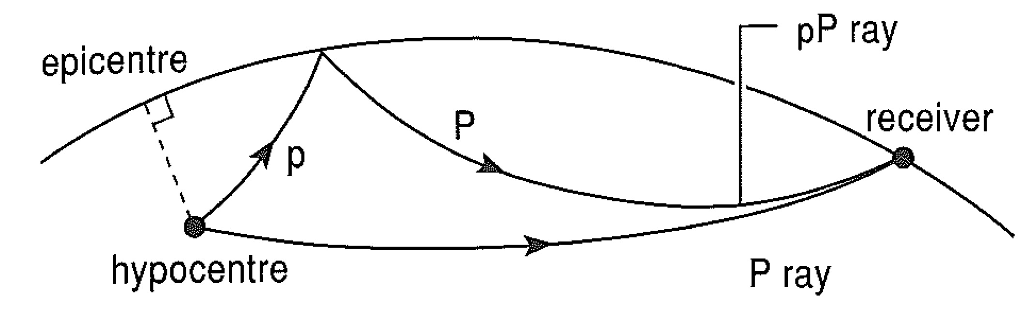
Hyocentral depth often a problem to determine accurately
The time between P and pP is proportinal to depth and therefore a good measure of the depth.

Slide 41
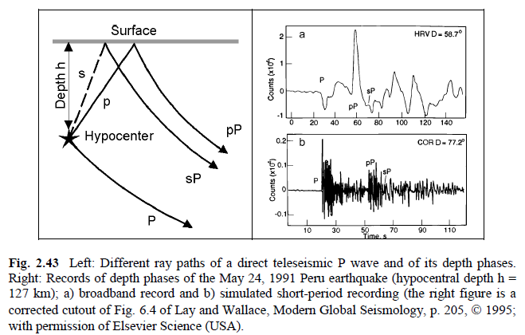
Example of pP

Slide 42
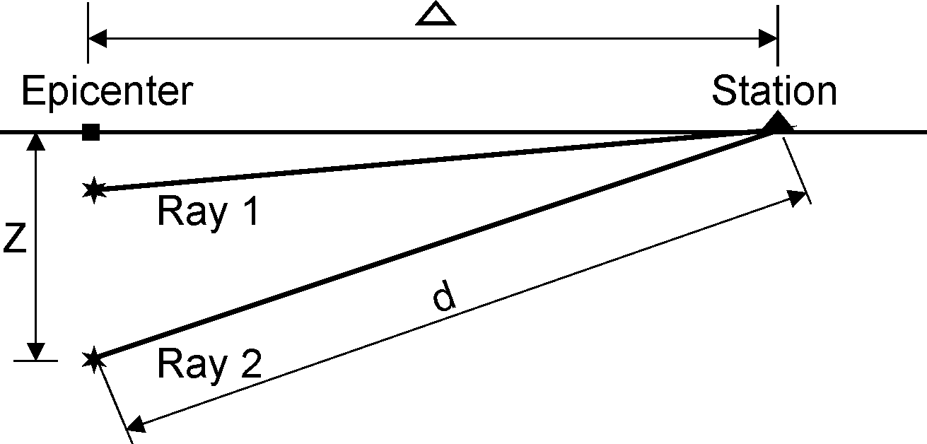
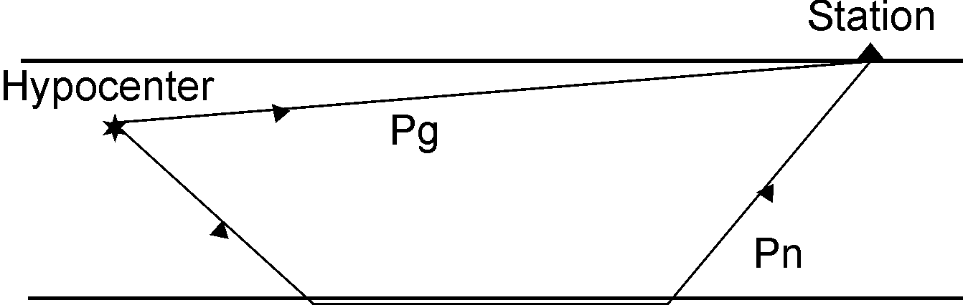
Depth of local eartquake
Local earthquakes: several stations within 2 times depth is required to get an accurate depth. Using Pg and Pn together also restricts the depth.

Slide 43
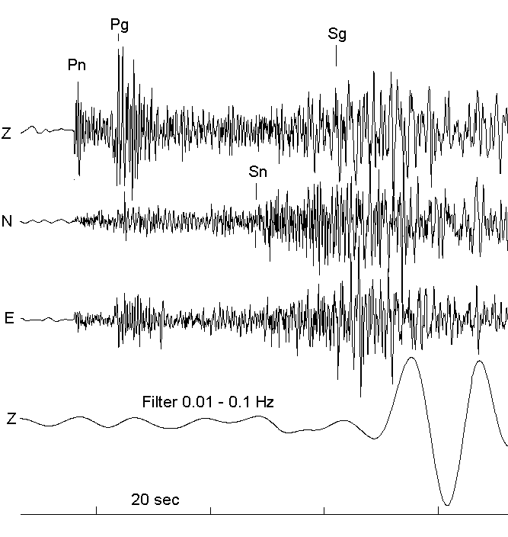
Detecting both Pg and Pn is often difficult

Slide 44
Conclusion
Locating earthquakes is not an exact science
With few stations it requires good skills to correctly identify phases
There is always errros in locations, often quite large
Error in depth is particularly a problem
Specialized methods can improve locations accuracy

